Slide 1
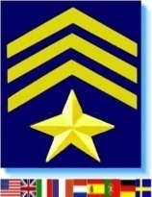
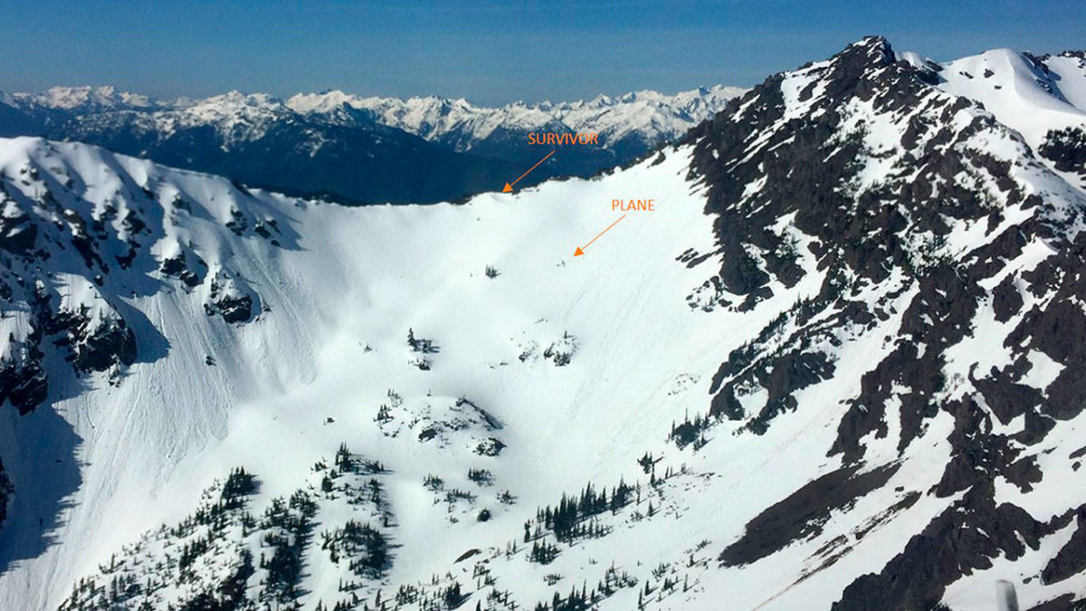
SAR Technology
Finding the Search Target is difficult…
Not finding the target is easy…
Notes:
Image Recognition Slide show contains 49 slides (#1 to #49) which take about 91 minutes to present. Take a break after Slide #39 – the multi-car search slide, at 69 minutes into the presentation. Continue from Slide #42 (the Searchlight webpage showing missing persons) up to the last slide #49.
Total slide duration (#1 to #49): 91min.
The four MP4 videos in slide #50 have a total duration of 22 minutes, allow 29 minutes to view these four videos.
Total Presentation time Slides #1 to #49 91 minutes (with a break after slide #39) + 29 minutes for the four videos = 120 minutes.

Slide 2
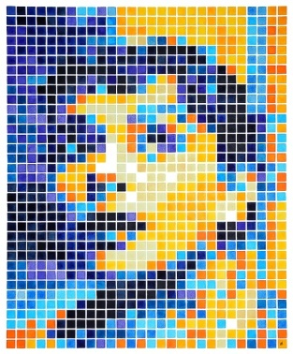
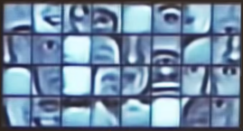
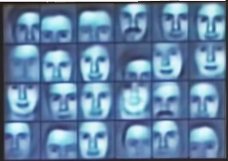
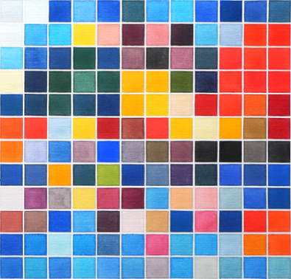
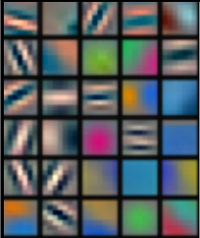
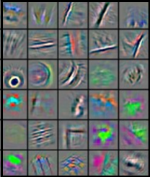
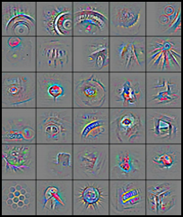
Image Recognition
Principle: Multi-Level Deep Neural Networks
- Image components are assembled into recognizable objects
Not finding them is easy…
Pixels
Edges
Object Parts
Object Models
- Mission images are then compared to reference libraries

Slide 3
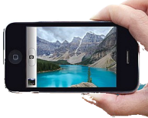
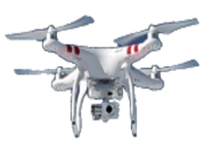
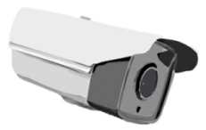
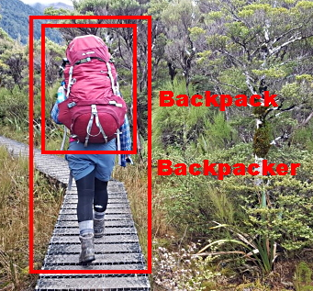
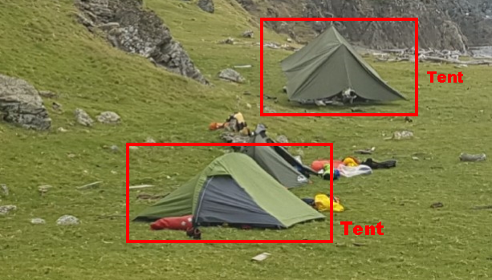
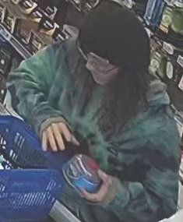
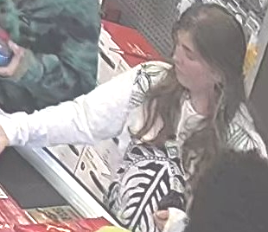
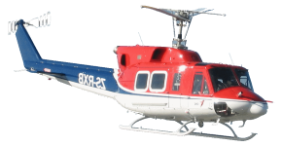
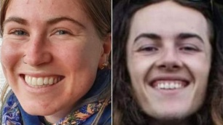
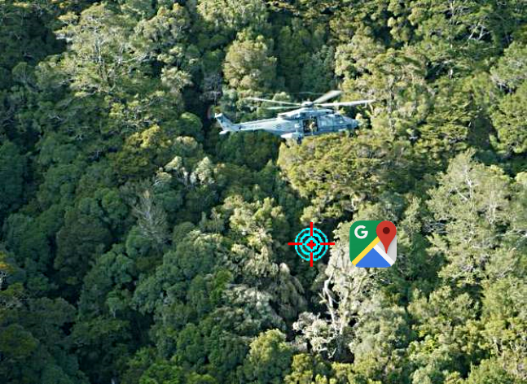
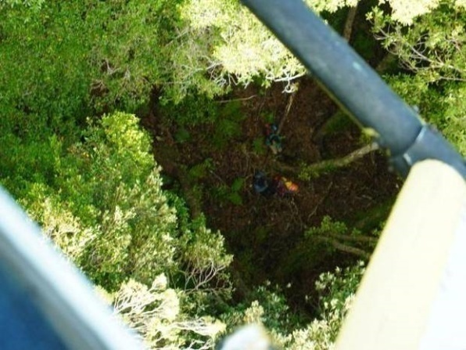
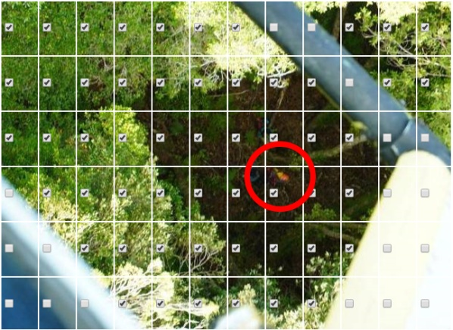
Image Recognition
Example Uses:
Public Sightings
Drone Images
CCTV Footage
Not finding them is easy…
- Perform Image-Recognition Flights

Slide 4
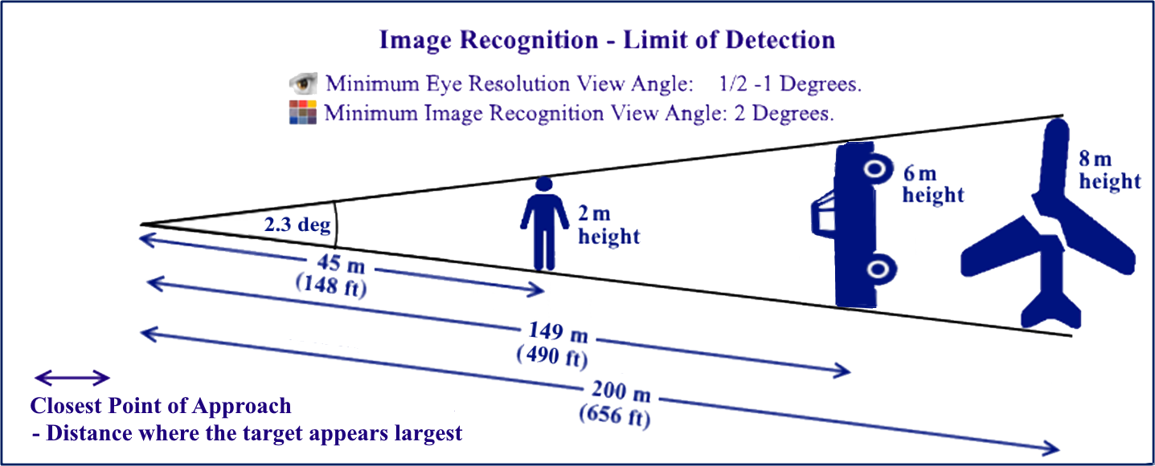
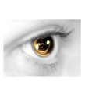
Image Recognition
Probability of Detection:
- Visual Limit of Detection
Not finding them is easy…
pixels

Slide 5
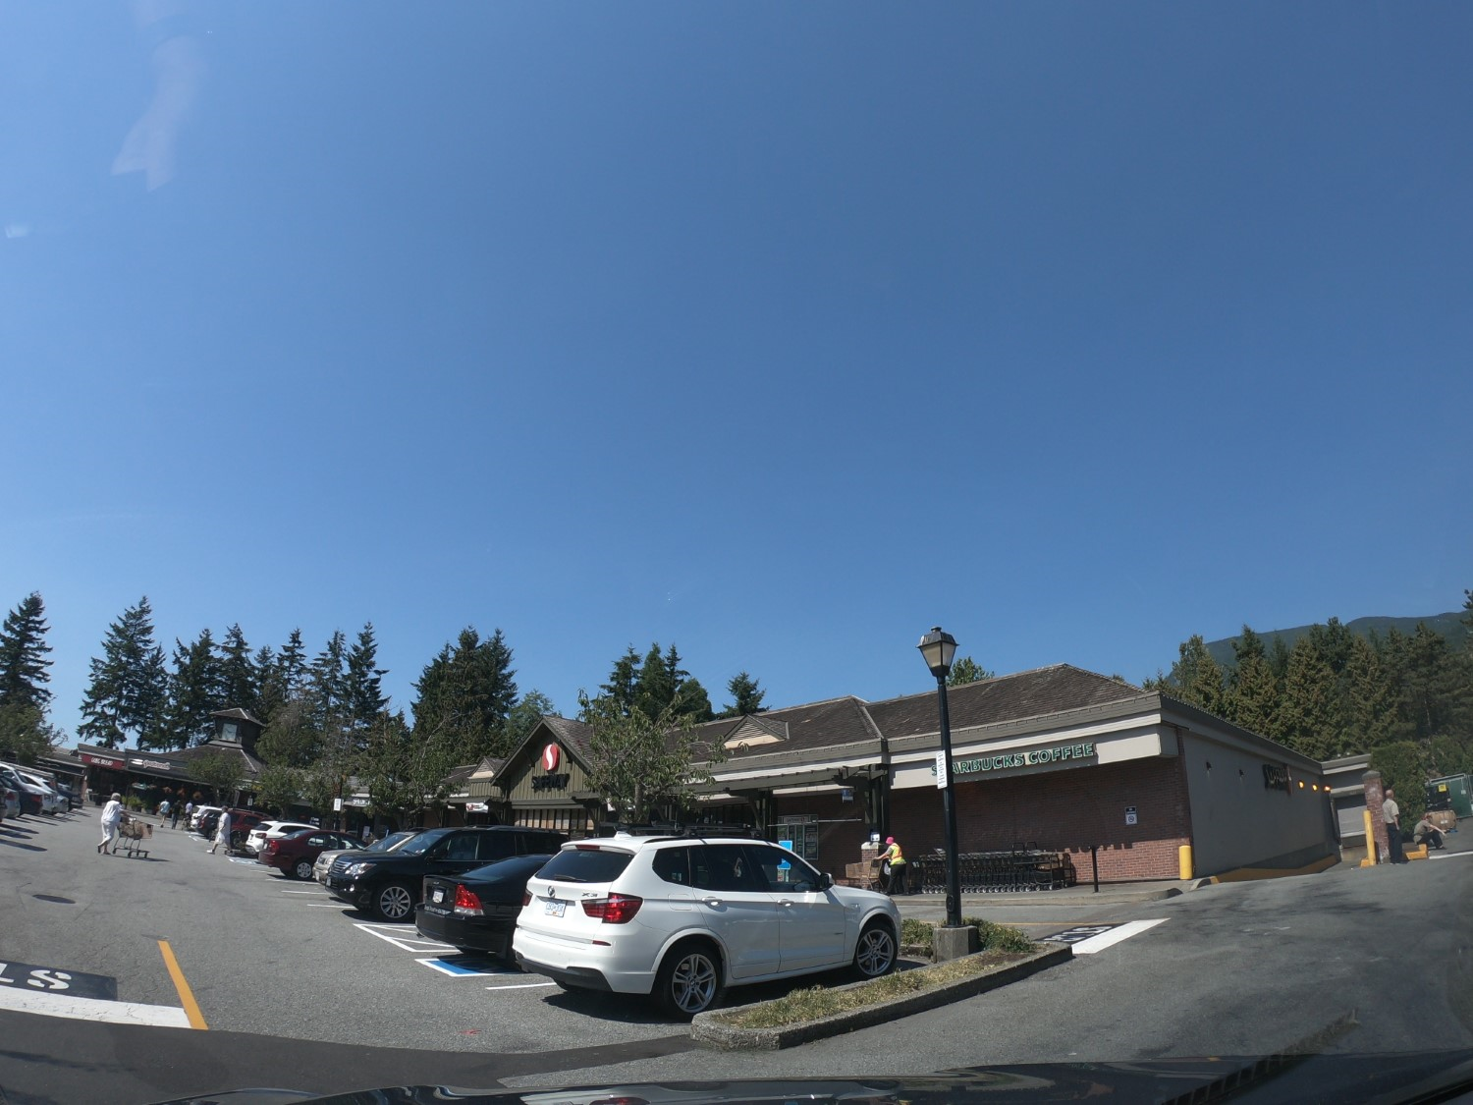
SAR Technology
Human Field of View
Persons
Human Field of View for Objects: 60 Degrees
60 Degree Human FOV for Objects
Image
as briefly seen
by the moving
Spotter
- Limiting
complete
detection.
(Peripheral vision)
Searching for Persons by the Moving Spotter.

Slide 6
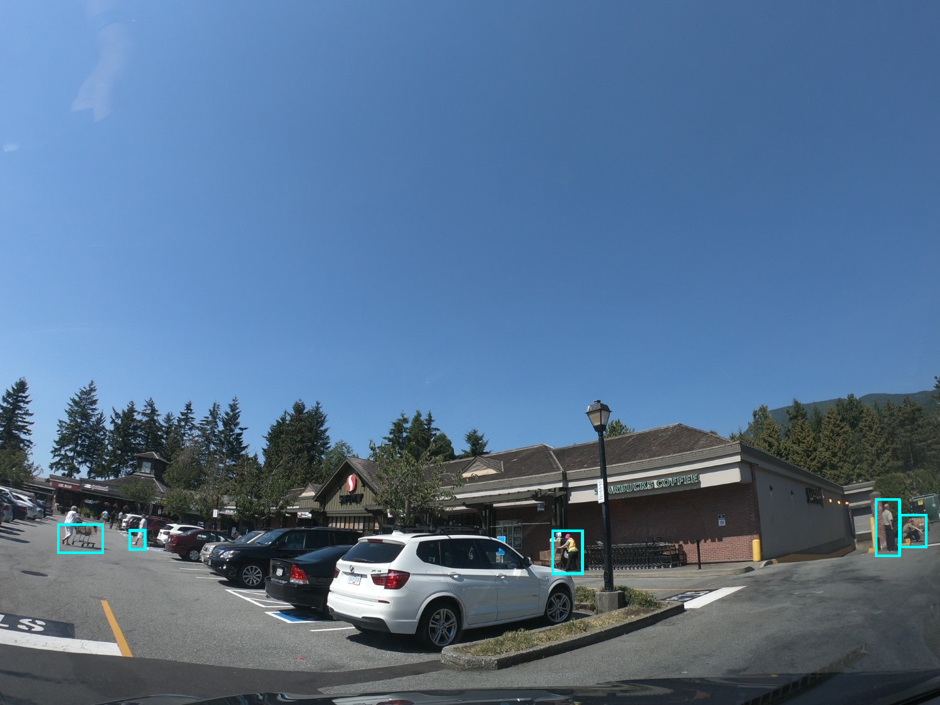
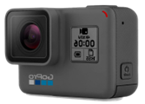
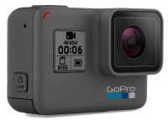
SAR Technology
\
5 Persons Detected
Camera Field of View
Multiple Detections recorded
Dual GoPro Cameras
Total 135 Degrees FOV for Objects
Partial or
Rotated
targets
Recognized
Permanent record of
the images
Searching for Persons by Image Recognition

Slide 7
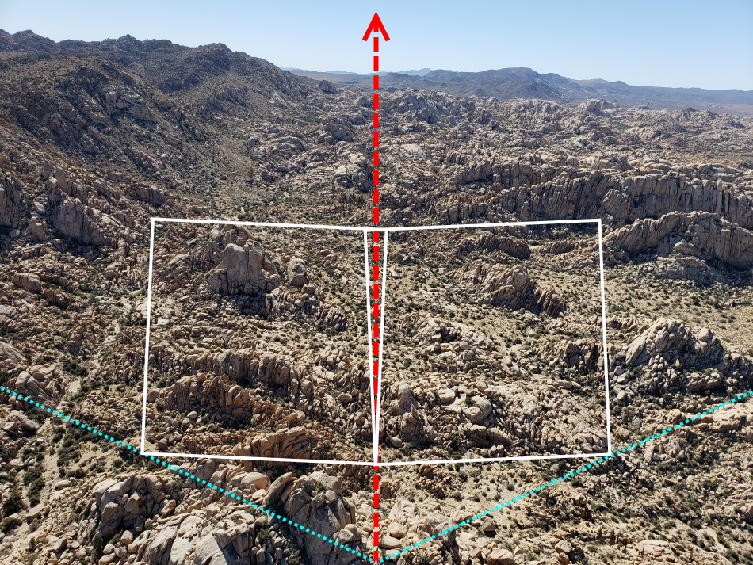
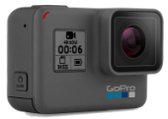
Image Recognition Flights
High-Detection Region
Trackline
Not finding them is easy…
Total High
Detection Regions:
188 m W
x 29 m L.
- from a
Helicopter
at 75 ft
AGL.
Total High Detection Regions:
1,252 m W x 196 m L
- from an
Aircraft
at 500 ft
AGL.
1 .5 Deg. View Angle – Good Detection
pixels
Left High Detection
Region
Right High Detection Region
70 Deg. Left Camera Field of View
70 Deg.
Right Camera
Field of
View
3 Deg. View Angle – Excellent Detection
Closest Point of Approach

Slide 8
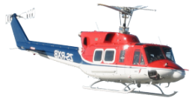
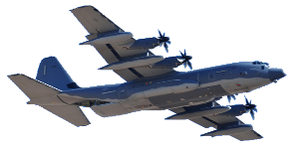
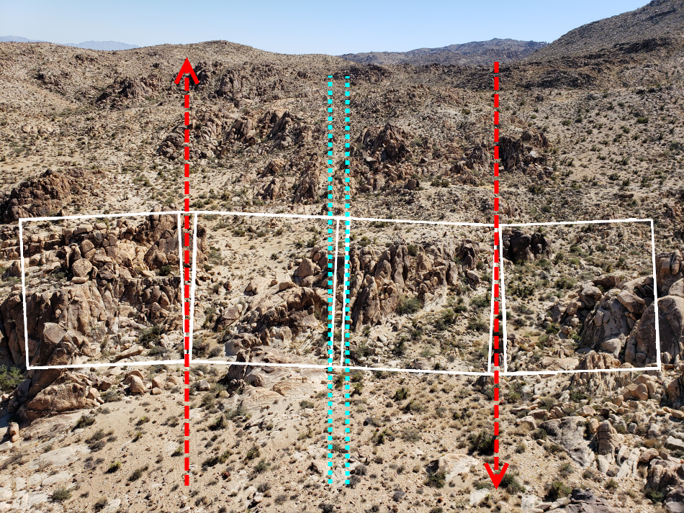
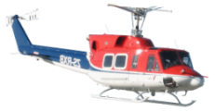
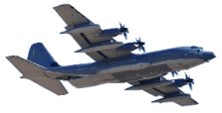
Image Recognition Flights
Aerial Grid-Search Pattern
Trackline
Image Overlap
Trackline
Not finding them is easy…
1 Deg. View Angle – Good Detection
pixels
Trackline
Spacing
169 m
- from a
Helicopter
at 75 ft
AGL.
Trackline
Spacing
1127 m
- from an
Aircraft
at 500 ft
AGL.
Left High Detection
Region
Right High Detection Region
2 Deg. View Angle – Excellent Detection
Closest Point of Approach

Slide 9
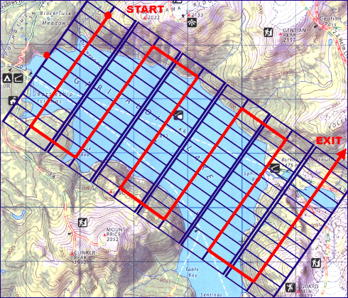
Image Recognition
SAR Image Requirements
Not finding them is easy…
1. High Resolution Images - lots of pixels.
2. Stabilized camera - to minimize blurring. 3. Adequate memory – to store hundreds of images. 4. GPS Location Logging – to record each image Lat-Long.
5. Forward-looking lens – for improved detection. 6. Multiple overlapping images – no gaps in coverage.
Every pixel counts.

Slide 10
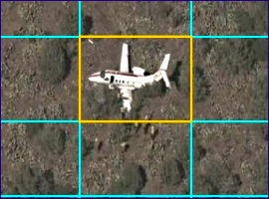
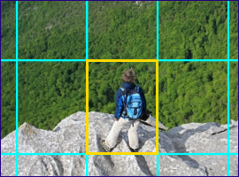
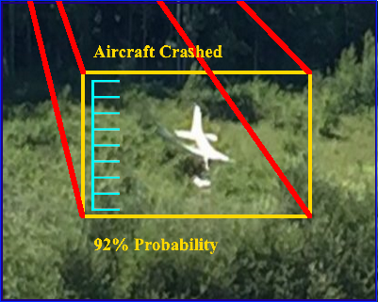
Image Recognition
Not finding them is easy…
Aerial Image Considerations
1. The target object is relatively small within the image. 2. Stable Flight – a low as possible to ground level. 3. Predefined GPS-logged Flight Plan Track – for full area coverage. 4. Image segmenting – for improved image recognition.

Slide 11
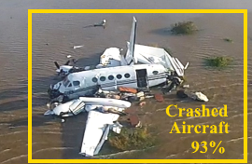
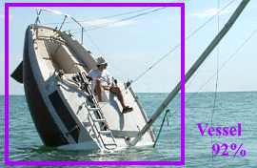
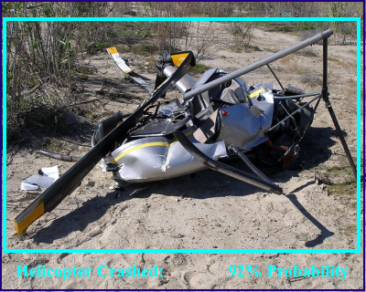
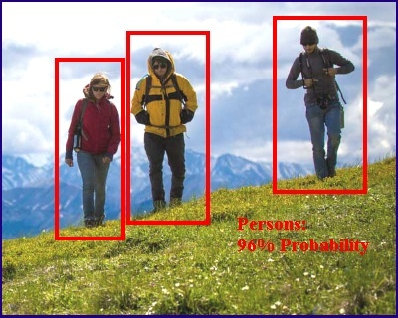
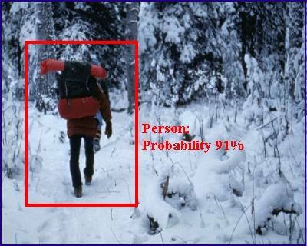
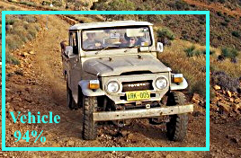
Image Recognition
Application: For Land, Sea and Air SAR Missions

Slide 12
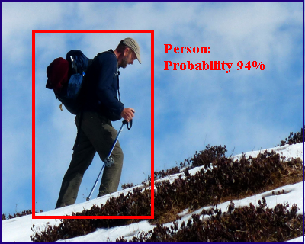
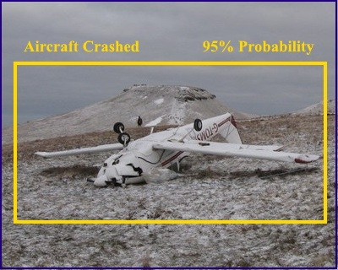
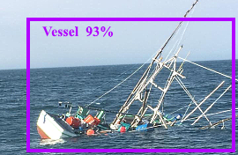
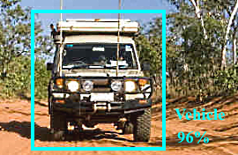
Image Recognition
Aerial Platforms for Land, Sea and Air SAR Missions
Target Objects:

Slide 13
Image Recognition
Image Recognition Benefits: 1. Enhanced Capability for the search responder.
2. Major Increase in Search-Area Size (50-200 times).
3. Double the Coverage - compared to a visual search.
4. Increased Detection - compared to the visual search.
5. Detects Rotated or Partially-Visible objects. 3. Increased Responder Safety - for dangerous terrain. 5. Permits brief mission ‘Windows of Opportunity’. 6. Permanent Record of the search area coverage. 7. Second opportunity to review and scan all the mission imagery.

Slide 14
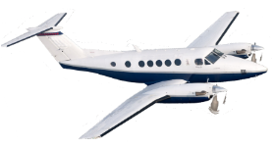
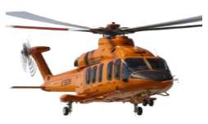
SAR Technology
Aircraft Flight Plans:
For Aircraft Altitude, Range, Speed and Endurance

Slide 15
SAR Technology
Drone Flight Plans:
For Drone Altitude, Range, Speed and Endurance

Slide 16
SAR Technology
3 Searchers
50 -200 Times the Search Area Coverage
for 6 Hours:
Resource Target
Ground Search 1.0 Sq. Km Searched Area
Image Recognition 51 Sq. Km Searched Area - 50X Larger Area
Image Recognition 216 Sq. Km Searched Area - 216X Larger Area

Slide 17
SAR Technology
Increased Operational Capability for GSAR Teams
GSAR Teams can search much larger areas (50-200X) than before. Fills the major operational gap between aircraft (too high/too fast)
- and traditional
ground-based small-area searching

Slide 18
SAR Technology
Default Flight Plans - for Enhanced Image Recognition

Slide 19
SAR Technology
Custom Flight Plans - for Image Recognition & Coverage
Flight Parameters: - Designed for Maximum Coverage. - Designed for Maximum Duration. - Designed for Maximum Detection. - Designed for Maximum Recognition.
Image Parameters: - Customized for Camera Angle. - Customized for Field of View. - Customized for Target Perspective. - Customized for Image Resolution.

Slide 20
SAR Technology
Custom Flight Plans - for Image Recognition & Coverage
Drone Flight Plan

Slide 21
SAR Technology
Dual GoPro Cameras - Mounted on Helicopter Windshield
Helicopter Hardware Setup
.
Cameras pointing to the Left-Side
& Right-Side of Flight Track-Line
Helicopter search result for 1/240th of image area (12X Zoom)

Slide 22
SAR Technology
Paul Miller Search
49 Palms Oasis Trail
Joshua Tree National Park Southern California
Missing Canadian on a short 2km hike.

Slide 23
SAR Technology
Paul Miller Search
49 Palms Oasis Trail
Joshua Tree National Park Southern California
Started around noon. Due back for flight home.
100 Deg F. No Water. No Shade. 1/2 Day Hike.

Slide 24
SAR Technology
California Highway
Patrol Helicopter
Image Recognition Flight Plan:
Speed: 30 Km/hr
Altitude: 100 ft AGL
Track Spacing: 132 m
No. of Cameras: 2 Image Interval: 5 sec. Search Areas: 6 Areas
Area Size: 16.2 Sq. Km Track Length: 126 Km
Duration: 4.2 Hours
No. Images: 7,567
Joshua Tree National Park Southern California
Crew: Pilot, Navigator and Two Spotters

Slide 25
SAR Technology
Left-Side & Right-Side
cameras both mounted
To windshield with
dual suction cup clamps.
Spotters ensure both cameras remain operating,
level and pointing to the left and right of the
helicopter’s centre-line.
Spotters visually scan the terrain during flight

Slide 26
SAR Technology
Persons Search
1.6 Km
6.2 Sq. Km
3.3 Km
Helicopter IR Flight Plan:
\
10 Sq. Km
100ft Alt. (AGL)
30Km/Hr
6.5 Km
132 m Track Spacing
126 Km Track Length
4.2 Flying Hours
16.8 Sq.Km Coverage
2 GoPro Cameras
Total Mtn Search Area 16.8 Sq.Km: 4.2 Flying Hrs
4 Seconds/Image
7,567 Images
Fast, Full-Coverage Searching of Large Areas in Limited Time.

Slide 27
SAR Technology – Image Recognition
Search Plan
Search
Plan:
Six areas of parallel
sweeps.
Speed: 30 Km/hr
Altitude: 100ft AGL
Navigator ensures that the helicopter flies directly along the search pattern track-lines.
Track Spacing: 132 m
Duration: 4.2 hours
Track Length: 126 Km
No. Images: 7,567

Slide 28
SAR Technology
Actual flight tracks on two days
Actual Searching
Completed:
Three
primary
areas searched
twice.
Three
secondary
Areas partially searched.
First day: 1.6 hrs 3,865 images taken
Total No. Images: 5,456 2020 images/hr (image every 1.8 sec.)
Second day: 1.1 hrs 1,591 images taken

Slide 29
SAR Technology
Image Recognition Search
Image
Recognition
Search Video
49 Palms Oasis Trail
Joshua Tree
National
Park

Slide 30
SAR Technology
Practical Tips:
- Clean the windshields. - Use a flexible lens hood to reduce flare and reflections.
- Use dual suction-cup mount.
- Mount GoPro’s low down to reduce sunlight glare. - Do not fly into the sun.
Fly away/across from the sun. - Use external USB battery pack for GoPro cameras.
Setup GoPro’s with QR Code. - Constantly monitor the
cameras and GPS flight track.
Every pixel counts.

Slide 31
SAR Technology
Left-Side & Right-Side
cameras both mounted
To windshield with
dual suction cup clamps.
Low camera mount location reduces overhead sunlight glare.
Spotters ensures both cameras remain operating, level and pointing to the left and right-sides of the helicopter’s centre-line.
Spotters visually scan the terrain during flight

Slide 32
SAR Technology
Image Post Processing – Identify ‘Objects of Interest’
Distant View of an Object of Interest

Slide 33
SAR Technology
Image Post Processing – Identify ‘Objects of Interest’
Close-Up Views of an Object of Interest
Embedded Lat/Long Location information identifies camera location.
Objects of Interest – Require Onsite Verification

Slide 34
SAR Technology
Example Mission: Shasta County Sheriff’s SAR
Cheryl McBee Search Whitmore, CA
Near Lassen National Forest California
Last seen in Whitmore, going to Lassen National Forest, where her vehicle was found.

Slide 35
SAR Technology
Typhoon-8 Drone Search – 72 images, 17,280 segments processed
Three segments containing Persons were found.
- In the top 3% of all the 17,280 segments searched.
1/240th-size segment insert showing two persons within the original full-size image.

Slide 36
SAR Technology
Typhoon-8 Drone Search – 72 images, 17,280 segments processed
Three segments containing Persons were found.
- In the top 3% of all the 17,280 segments searched.
1/240th-size segment insert showing one person within the original full-size image.

Slide 37
SAR Technology
Danial Kosarifor Search Lions Bay SAR, BC
South Face of Mount Brunswick
Hiker Trapped on a ledge on the
South Face of Mount Brunswick
High Image Recognition Score

Slide 38
SAR Technology
Murray Naswell Search Strathcona Park, BC
Image Recognition Flight Plan
Mt. Albert Edward
\
Helicopter IR Flight Plan:
Contour Search
50 Km/Hr
176 m Track Spacing
75 ft Altitude AGL
2 GoPro Cameras
2 Seconds/Image
Subject left notes in Mt. Albert-Edward summit log

Slide 39
SAR Technology
Murray Naswell Search Strathcona Park, BC
Mt. Albert-Edward 6,867 ft
Subject Found Alive at Moat Lake
Hiker trapped on a cliff for 32 hours
before descending to Moat Lake
Search Results:
In top 1% of Images

Slide 40
SAR Technology
Vessel Search using Long-Range Drone Aircraft
- Beyond Line of Sight Civilian Fixed-Wing Drone
- 88 Km Offshore Round Trip
- 800 Ft Drone Altitude
Location: East Irish Sea
- Excellent Image Recognition for Vessels
Target Object
Unmanned, Long-Range, Over The Horizon Flight

Slide 41
SAR Technology
Missing Vehicle Search
Rapid Long-Range Recognition of Multiple
Vehicles
Notes:
Image Recognition Slide show contains 49 slides (#1 to # 49) which take about 91 minutes to present. Take a break after Slide #39 – the multi-car search slide, at 69 minutes into the presentation. Continue from Slide #42 (the Searchlight webpage showing missing persons) up to the last slide #49
Total slide duration (#1 to #49) 91min.
The four MP4 videos in slide #50 have a total duration of 22 minutes, allow 29 minutes for these four videos.
Total Presentation time Slides #1 to #49 91 minutes (with a break after slide # 39) + 29 minutes for the four videos = 120 minutes.

Slide 42
SAR Technology
Online Web Page
‘Searchlight ‘ Image Processing:
Scan images on the ‘Searchlight Image Locater’ web-page.
- Sort for high-scoring ‘Person’ images.
Print PDF report of each web-page result. Post Processing: - Identify ‘Objects of Interest’ images.
- Perform follow-up onsite search of each
geo-tagged ‘Object of Interest’ image.

Slide 43
Batch search mission images for the missing Aircraft, Helicopter, Vehicle, Vessel or Person.
Batch Search by Image:

Slide 44
Batch search mission images by Color for the Aircraft, Helicopter, Vessel, Vehicle or Person.
Batch Search by Colour:

Slide 45
SAR Technology
Colour Search for Small Objects
Crown Mtn. B.C.
Colour Search Benefits:
- Detects specific colours in terrain.
- Detects very small areas. - Detects irregular shapes. - Detects blurred shapes. - Detects at longer distances than objects.
Every pixel counts.

Slide 46
SAR Technology
Colour Search
Noah Mina Search, Kapilau Ridge, Maui. 8.8 Sq.Km

Slide 47
SAR Technology
Michael Gazetas Search – Vancouver Island – Searching for a Red Truck
Full Heli Crew,
- with 3 Spotters per flight. 2 GoPro Cameras.
4 Heli Flights. Duration: 16 Hrs # Images: 45,000

Slide 48
SAR Technology
Michael Gazetas Search – Vancouver Island
Spotters finds: 1 Target Object Image Review finds: 6 Target Objects
Red Object – Spotters & Image Review
Two Red Vehicles – Image Review
Snow-Covered Vehicle – Image Review
a
Red Garbage Truck- Image Review
Red Highway Sign – Image Review
Snow-Covered Vehicle – Image Review

Slide 49
SAR Technology
‘Searchlight’ - SAR Partners

Slide 50
SAR Technology
Making SAR – Faster – Safer - Smarter

Slide 51
SAR Technology
‘Searchlight Image Locator’ Web-Page
- Online Training Videos
Image Search
Image Segmentation (for Aerial Images)
Colour Search
Keyword Search
[…..]
Notes:
Image Recognition Slide show contains 49 slides (#1 to #49) which take about 91 minutes to present. Take a break after Slide #39 – the multi-car search slide, at 69 minutes into the presentation. Continue from Slide #42 (the Searchlight webpage showing missing persons) up to the last slide #49.
Total slide duration (#1 to #49): 91min.
The four MP4 videos in slide #50 have a total duration of 22 minutes, allow 29 minutes to view these four videos.
Total Presentation time Slides #1 to #49 91 minutes (with a break after slide #39) + 29 minutes for the four videos = 120 minutes.

