Slide 2
INTRODUCTION
Incident Commander Pro is a powerful fully-integrated set of management tools designed to improve the organization and effectiveness of search, rescue and emergency response missions:
It blends the organizational structure of the Incident Command System (ICS) with the latest developments in the science of search theory.
It provides a complete framework for managing any type of Search, Rescue or Emergency Response mission with a comprehensive set of Command, Operations, Planning and Reporting forms.
Extensive databases of missing person behaviour and probability of detection (POD) tables provide a field-based foundation for mission planning scenarios.
A set of integrated logistic calculators automatically optimize the mission's options to provide the greatest overall probability of success.

Slide 3
Additional Features
Incident Commander Pro can be used to store information on team members and other persons of interest:
Personal information and affiliations.
Personal skills and training levels.
Personal equipment and local knowledge.
Training courses and comments.
Incident Commander Pro can also be used to record individual attendance at meetings, displays and other events.

Slide 4
Disclaimer
THE INCIDENT COMMANDER PROGRAM IS A TOOL TO HELP EXPERIENCED INCIDENT COMMANDERS PLAN AND MANAGE THEIR MISSIONS MORE EFFECTIVELY.
THE PROGRAM IS NOT A SUBSTITUTE FOR EXPERIENCE.
IT SHOULD BE USED ONLY BY SKILLED INCIDENT COMMANDERS TO ASSIST THEM IN MAKING THEIR OWN PLANNING AND
EMERGECNY MANAGEMENT DECISIONS.

Slide 5
Text Boxes used in this presentation…
Blue text boxes identify items.
Green text boxes indicate an action is to be taken.
Pinkish text boxes provide warnings, tips and additional information.

Slide 6
Emergency Response and ‘Incident Commander Pro’
The organization and control of an emergency situation is accomplished using the Incident Command System (ICS).
Incident Commander Pro (IC Pro) has been developed to assist persons managing search, rescue and emergency response missions, and present reports in a standard ICS format.
IC Pro organizes and displays information in a manner that helps managers to analyze information, make decisions and develop strategies for dealing with the situation.

Slide 7
Incident Command System (ICS) Architecture
The ICS Command, Operations, Planning and Logistics functions are included in the IC Pro software, but Finance is not.
For detailed duties and responsibilities of each section refer to the ICS manual.
Command
Operations
Section
Planning
Section
Logistics
Section
Finance
Section
Incident Command System Diagram
The records and data used by each ICS section are stored under tabs with the same names in IC Pro.

Slide 8
Opening ‘Incident Commander Pro’

Slide 9
Opening ‘Incident Commander Pro’
Double Click the Incident Commander Pro icon on the Desktop.
The Incident Commander Pro banner appears for a few seconds.

Slide 10
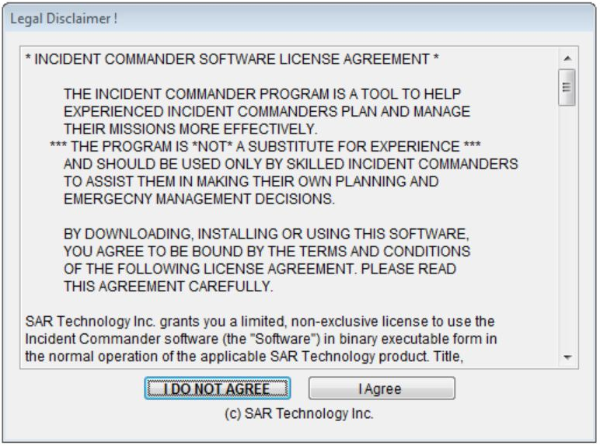
Legal Disclaimer
Click “I Agree” to continue.

Slide 11
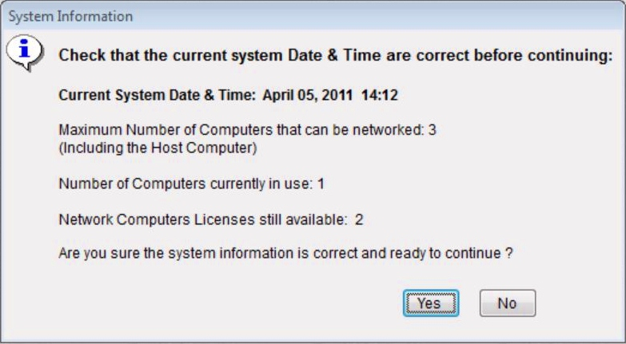
System Information
The Date and Time shown here will be used as the “Official Time” for all events. Ensure it is correct, especially if you are working on a network. Change incorrect items before clicking OK.
Click Yes to Continue.

Slide 12
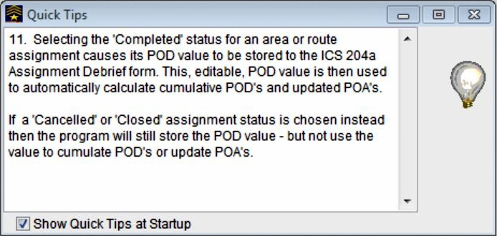
Quick Tips
Quick Tips provide a review of many easily forgotten topics and procedures.
Uncheck if you don’t want to see Quick Tips.

Slide 13
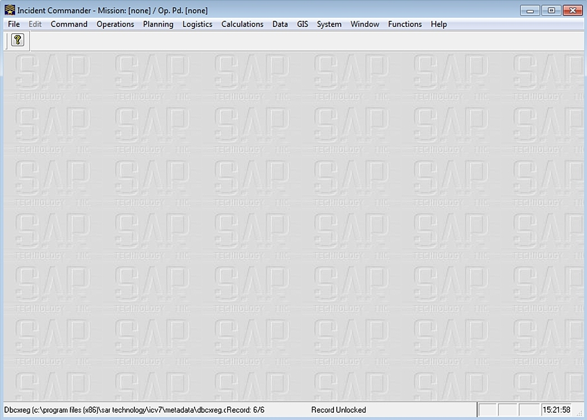
Main Page
The Main Page displays the Main Menus and other relevant data.
Main Menus
Time

Slide 14
A Quick Tour

Slide 15
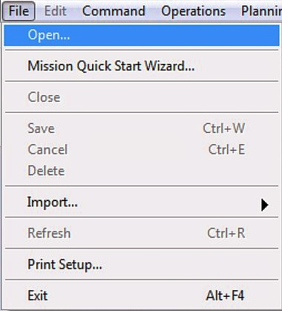
File Menu
The File Menu performs basic administrative functions.
Bold File menu items are available. Other items will become available as their functions are needed.
Many items can only be deleted by using the File – Delete function. This is a safety feature to ensure important information is not mistakenly deleted.

Slide 16
File Menu – Main Functions
Opens an existing mission.
Provides a fast way of initiating a new mission in an orderly manner.
Permits personnel data to be imported into the Personnel Table.
Prints reports, maps etc.
Closes Incident Commander Pro
The remaining menu items perform normal Windows functions.

Slide 17
Edit Menu
The Edit Menu performs.
Bold File menu items are available. Other items will become available as their functions are needed.
Many items can only be deleted by using the File – Delete function. This is a safety feature to ensure important information is not mistakenly deleted.

Slide 18
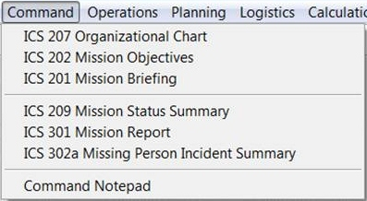
Command - 1
The Command menu displays the Organization Chart and other screens that provide a snapshot of mission status and progress.
Shows the command structure and the members assigned to key positions.
Documents the objectives for the current operational period.
Provides incoming personnel with a brief overview of the mission.

Slide 19
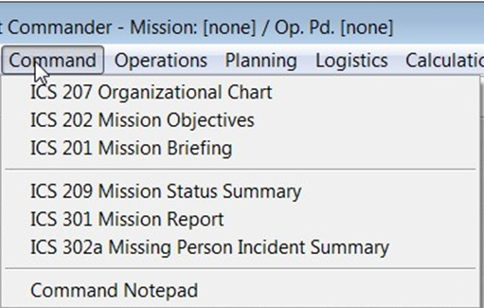
Command - 2
Summarizes the status of mission assignments performed during the previous operational period.
A brief summary of the current status of the mission to keep the tasking agency informed.
A summary of the incident and how it was resolved. It is used for improving future SAR techniques.
Used to collect information needed to formulate mission objectives (ICS 202).

Slide 20
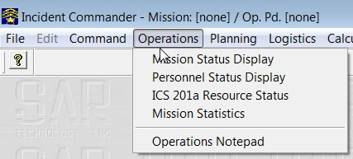
Operations - 1
The Operations Section is responsible for directing and coordinating all tactical activities for the mission.
Provides real time status of the mission operations plan and its assignments.
Shows the status of all personnel who are checked in to the task.

Slide 21
Operations - 2
Provides an overview of all registered resources available to the mission
A place to put notes on operations matters.
A continually updated snapshot of the current mission resources, assignments and personnel.

Slide 22
View Mission Statistics
View Mission Statistics displays regularly updated Mission Statistics
Click Operations, then Mission Statistics to open the display.
The little “clock” on each item momentarily turns green when the item is updated.
Click the check boxes to select the statistics to be displayed.

Slide 23
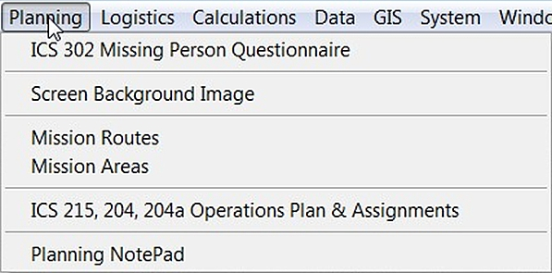
Planning - 1
The Planning Section collects and evaluates information and creates operations plans for the task.
Information about a missing person(s).
You can replace the default image with another image.
A list of routes to be travelled, searched or examined.
Default Mission Routes or routes created specifically for the current mission can be used.

Slide 24
Planning - 2
The Planning Section collects and evaluates information and creates operations plans for the task.
A list of geographic areas to be included in the current active mission.
A list all assignments created or remaining active within the latest operational period.
A place to record details for each planning item.
Default Mission Areas or areas created specifically for the current mission can be used.

Slide 25
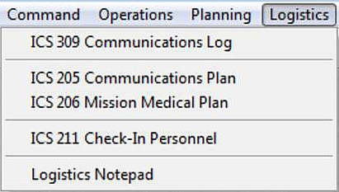
Logistics
The Logistics Section provides services and support to the mission.
ICS 309 Communications Log – Displays the Communications Log.
ICS 205 Communications Plan - Displays the Mission Communications Plan
ICS 206 Mission Medical Plan – Displays the Mission Medical Plan.
ICS 211 Check-In Personnel – Displays the names of all personnel who have checked-in to the task.
Logistics Notepad – Create, store and show user created Logistics notes.
Default Communications and Medical Plans can be used as Mission Communications and Medical Plans.

Slide 26
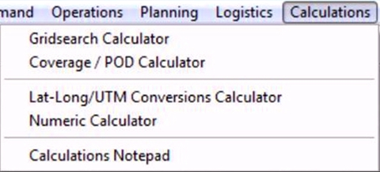
Calculations
A group of calculators to simplify and speed up SAR operations.
Calculates the Number of searchers or the Total Search Hours required to search a pre-defined area.
Calculates the Coverage and %Probability of Detection (POD) of search tracks within a defined area.
Converts between Latitude-Longitude and Universal Transverse Mercator (UTM) geographic coordinates
A place to record the details of calculations performed during the current mission.
Performs standard numeric calculations; add, subtract, multiply, divide, percentage, square root and memory store functions.

Slide 27
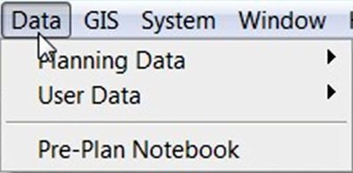
Data
Data files store information used by the IC program. Some data files are fixed and cannot be changed by the user, and other files can be created by user input.
Interactive information tables; POD, Subject Behaviour Profiles, Travel Speed and Mission types.
Personnel ,Skills Training, and Organizations, Default Routes and Decision Points, Default Areas, Default Communications and Medical Plans, Resource Types and Equipment.
A place for user created Pre-Plan notes.

Slide 28
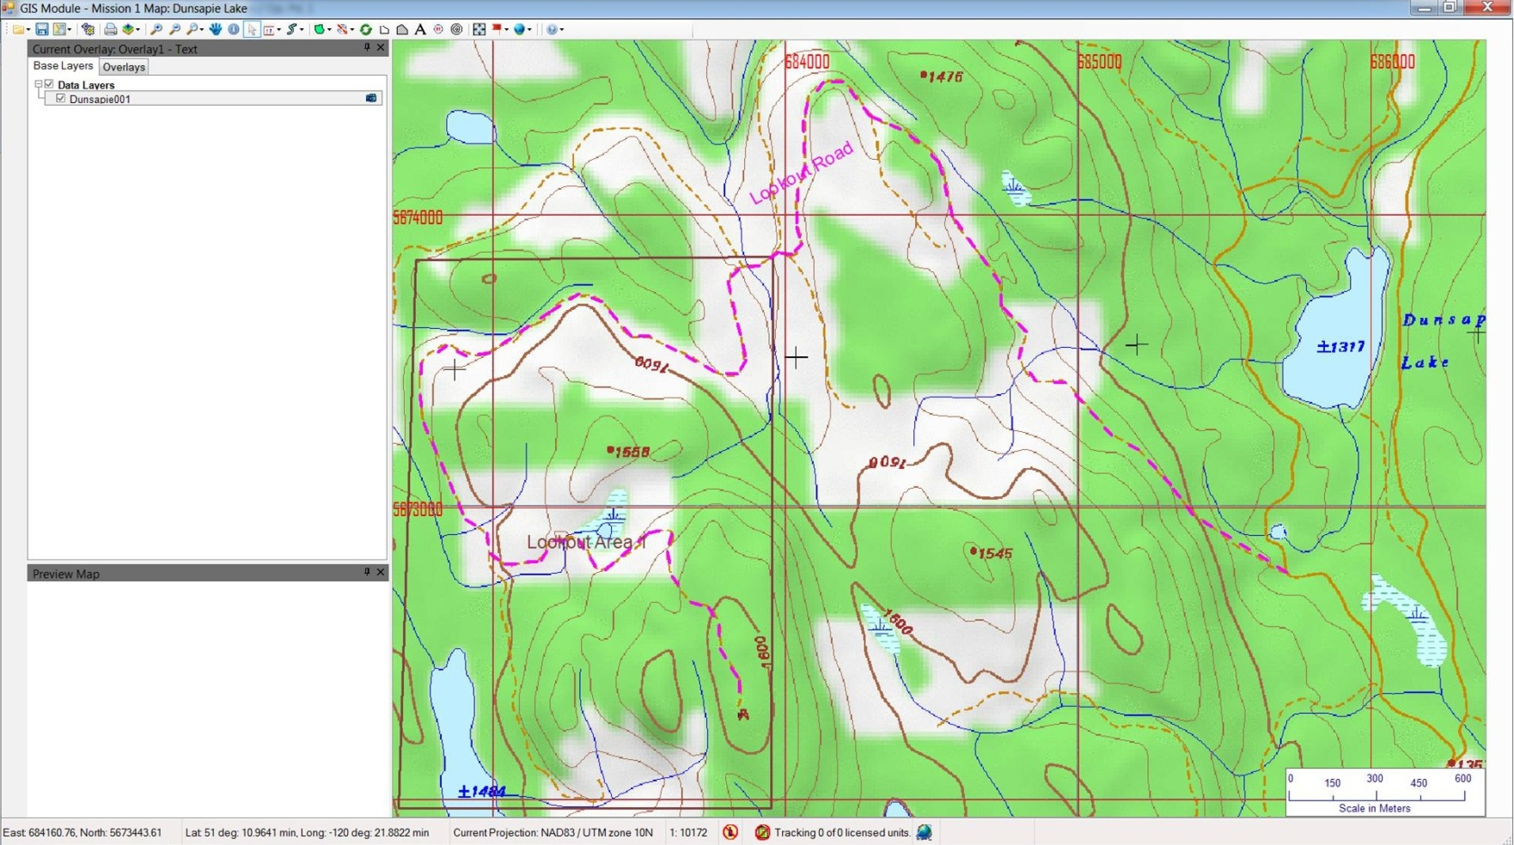
GIS Module
The GIS module permits incident maps to be created, by the addition of map layers containing a wide variety of data and information.
Click to display the Mission Map.

Slide 29
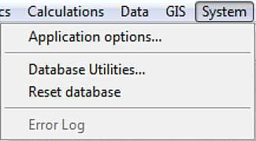
System
Selects the language, system of measurement, background, and organization logo.
Selects the language, system of measurement, background and organization logo.
The Database Utilities menu provides a number of functions to maintain the program's databases.
Resets Incident Commander's database pointers. It does not change the data.
The Error Log provides information for documenting errors within the Incident Commander program and the computer or network.

Slide 30
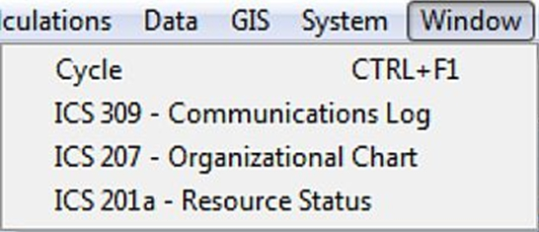
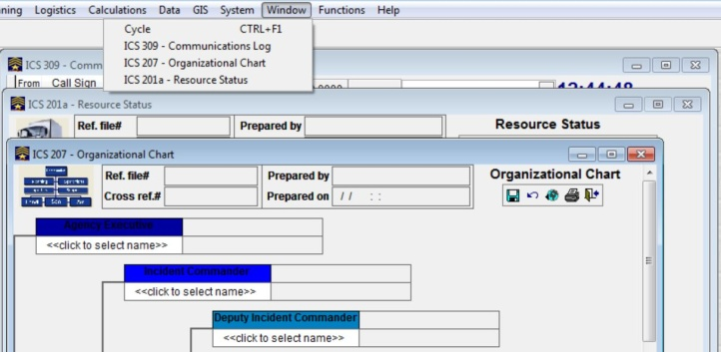
Window
The Window menu displays a list of all active windows.
Click Cycle to cycle through the active windows.
Active windows are listed here.
Click the Window name to select it for use/editing.
You can also click on an active Window to bring it to the front.

Slide 31
Functions
The Functions menu allows other programs to be run from within Incident Commander.
Click External Programs to open the Program List.
Double Click a blank row to enter Add mode.
Locate the program you wish to add then click the .exe file.
You may rename the .exe file to make it easier to identify the program.

Slide 32
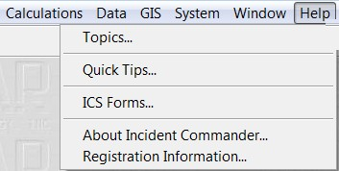
Help Menu
The Help menu provides program help and other information.
Topics - Contains a just about anything you need to know about using the program. Don’t forget to use it!
Tips on how to best use the program.
A complete set of ICS forms that may be printed out.
Information on the program and its version number.
Registration status and the number of computers registered.

Slide 33
Standard Tool Bar
Every data entry screen has a tool bar in its upper right hand corner, as shown here.
Go to the first, next, previous and last data form.
Save the current data form.
Refresh.
Open a new data form.
Close the record.
Undo the last entry.
Remember to click the “Open New Data Form” icon before trying to create a new data form.

Slide 34
Sizing a Window
Place the cursor on the border. When the double arrow appears pull the border to the desired position.
Not all windows can be resized.
On some windows only the bottom can be resized.
Not all columns within a window can be resized.

Slide 35
Sizing Column Widths
1. Hover cursor over the column edge of the title bar until the double arrow appears.
2. Left click and hold, then pull column edge to desired location, then unclick.

Slide 36
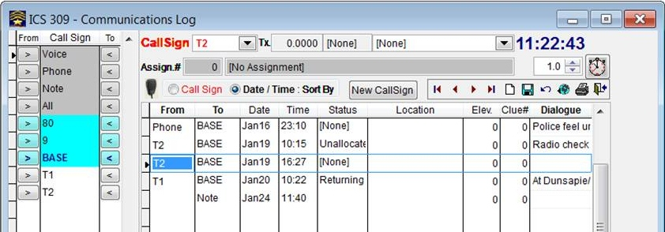
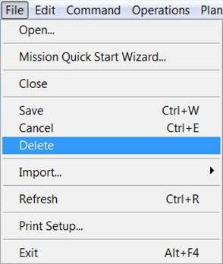
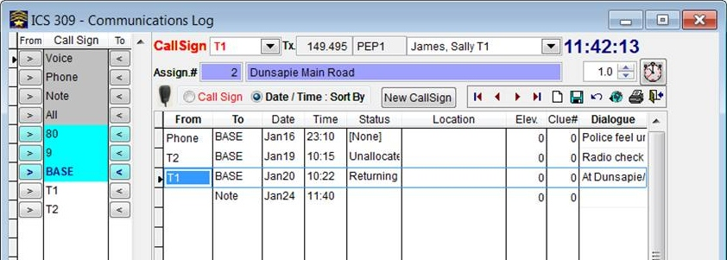
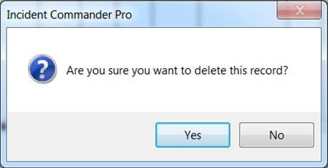
Delete Data
1. Select the item to be deleted.
2. Select File, then Delete.
3. Click Yes to confirm the deletion.
The selected item is deleted.

Slide 37
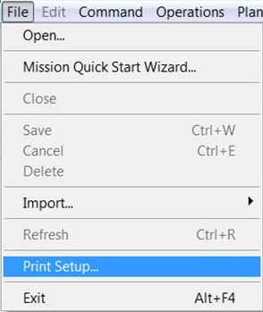
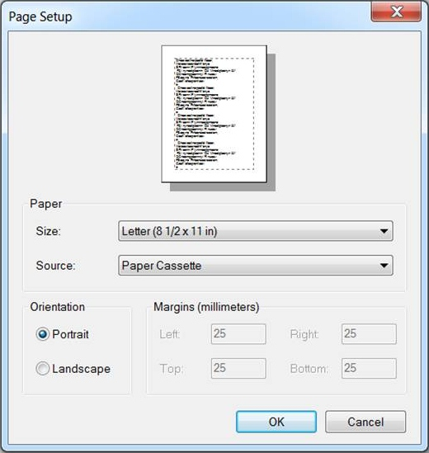
Print Setup
The Print Setup menu sets the print page parameters.
1. Click File, then Print Setup.
2. Select the needed items.
Paper size is usually Letter (8 ½ x 11 in).
Source is usually Paper Cassette.
Orientation varies with tie item you are printing out.
Margin sizes are normally fixed.

Slide 38
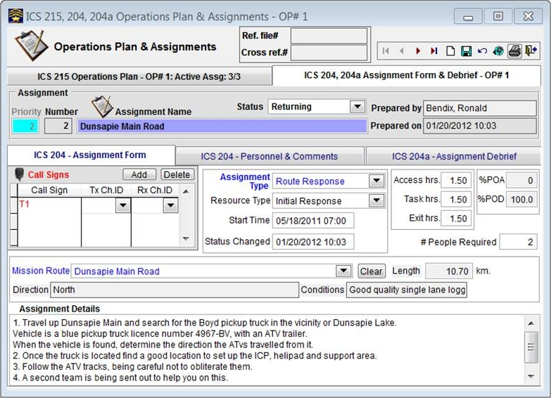
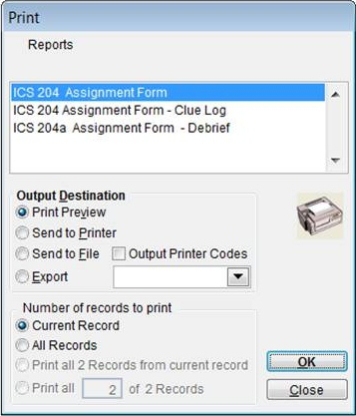
Print Report - 1
1. Click on Print to open the Print menu.
2. Select the Report to be printed.
3. Select an Output Option.
4. Select the Number of records to print.
5. Click OK to print.

Slide 39
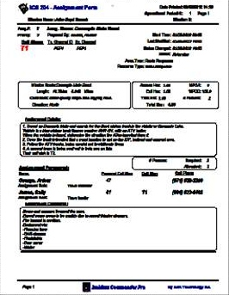
Print Preview
3. Print the document.
1. Select page to view.
4. Close Print Preview.
2. Zoom page image size for better readability.

Slide 40
Preparing for Use

Slide 41
Computers and Things...
Computer power Supplies:
All computer equipment should be connected to the AC power source through an Uninterruptable Power Source (UPS), particularly if AC power is supplied by a generator.
A UPS also ensures laptop computers do not shut down as a result of a dead battery.
Computer power should be set to Always On (C:/Control Panel/Put computer to sleep = Never)
Networking:
Wired networks are more secure and less likely to fail than Wireless networks.
Always turn the Host computer on First, and turn it off Last.
Different computer models display information in slightly different ways.

Slide 42
Before we start...
1. You must create or open a mission before you can enter data in most records.
2. Many forms collect and display information and cannot be changed or edited.
3. The program runs in real time and most items are stamped with the actual date and time of occurrence. The time can be altered on some records.
4. Information displayed on most forms is for the current Operational Period only.
5. When you close an editable form the information on it is saved automatically.
6. Regularly save the entire IC folder to another location, with a new file name.
7. To delete a record use File then Delete. This is a safety feature to prevent unintended deletions.
8. Some Data Entry records cannot be closed if left blank. To close them enter a single character on the first line, Close, then Delete the entry with File – Delete.
9. If a person or asset is not Signed In to the program, it cannot be used.
10. Forms identified as ICS nnn are standard ICS forms modified for computer use.
11. Information in dark gray areas is automatically entered by the program.

Slide 43
Before we start... Definitions
Missions and Tasks – The Incident Command Program uses the term Mission to define the entire operation and Task to define an operation within the mission .
Default Missions – A default mission can be created by opening a new mission and assigning it a name such as “Default 1” and changing the Operational Period to “0”. Enter default information such as names, routes and maps etc. To convert it to an active mission, change the name, add a Reference File # and select an Operational Period.
Pre-plans – Plans that are prepared before a mission begins. Examples are Personnel Tables, Communications and Medical plans and other plans that can be used on more than one mission.
Default Areas and Routes – Areas and routes commonly used on a number of missions.
Pre-plans and Default Areas and Routes can be prepared without first opening a mission.

Slide 44
Preparing For Use
Before using Incident Commander for the first time the following steps should be taken:
Review the installed Mission Types and add other types if needed.
Enter information about your organization and other organizations on the Organizations table.
Enter names and other information on the members of your organization and other persons on the Personnel Table.
Enter Default Communications and Medical Plans.
Enter other default plans and information such as commonly used Routes, Areas and Resources.

Slide 45
About Default Plans
Default plans are stored in the Data - User Data files:
Default Mission Data for the Medical plan, Default Routes and Default Areas will be automatically loaded if their check boxes are checked in the System - Application Options - General tab.
Default Routes and Mission Areas can also be selected on the Mission Quick Start Wizard at Step 3, or not used by clicking the Minimal box on the Mission Quick Start at the top of the Wizard.
The Default Communications Plan is always loaded when a new mission is created. It can be easily modified to suit the mission needs at Logistics – ICS 205 Communications Plan.

Slide 46
Preparing for Use
Entering User Data

Slide 47
Data
Information that is used for most missions is stored in the Data section.
Data tables and information to aid in the planning of missions and tasks.
Data tables and information about Personnel, Organizations, Default Plans and Resources.
A place to store notes and comments Default Plans and Resources.
Put as much information as you can into the Data tables as this will save you a lot of valuable time during a mission.
Check and update the data regularly.

Slide 48
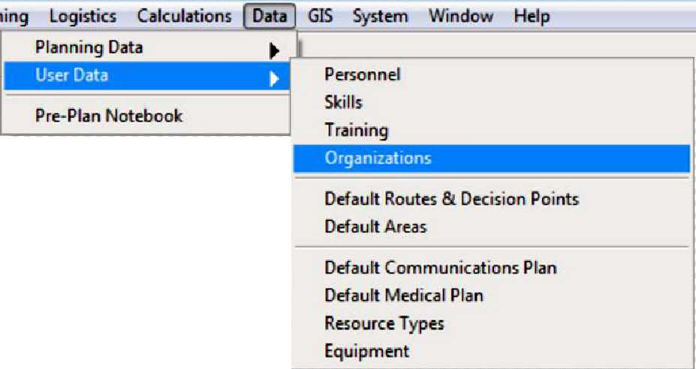
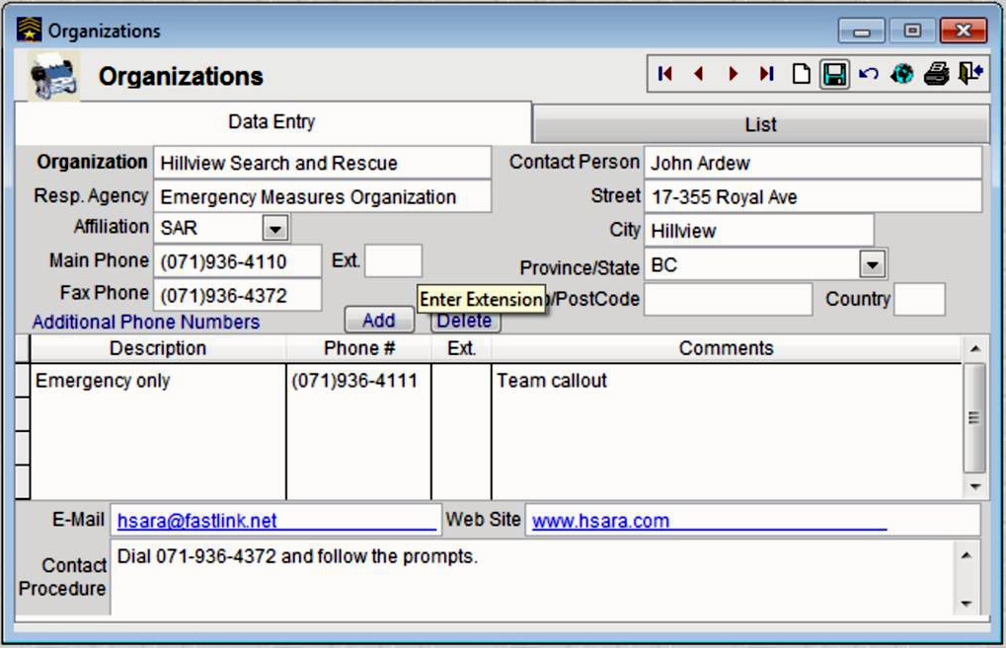
Entering Organizations Data
1. Click Data, User Data then Organizations to open the form.
2. Click New then Data Entry.
4. Start at Step 2 if you have more Organizations to enter.
3. Click Save when you have completed the form.

Slide 49
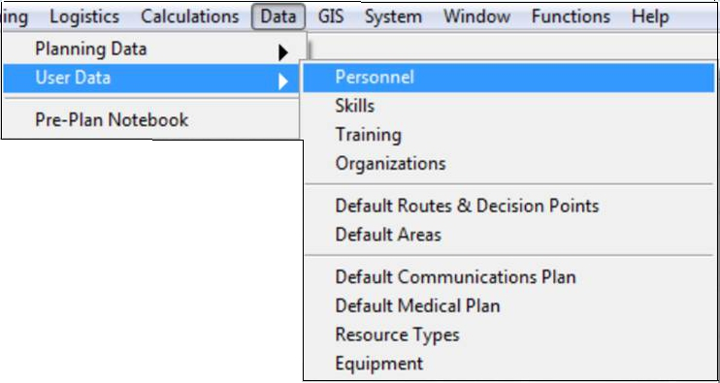
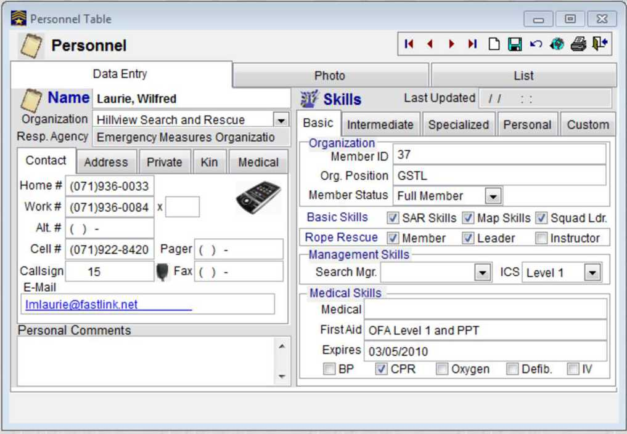
Entering Personnel Data
1. Click Data, User Data then Personnel to open the form.
2. Click New then Data Entry.
4. Start at Step 2 if you have more Personnel to enter.
Ensure you enter data for all relevant tabs.
3. Click Save when you have completed the form.

Slide 50
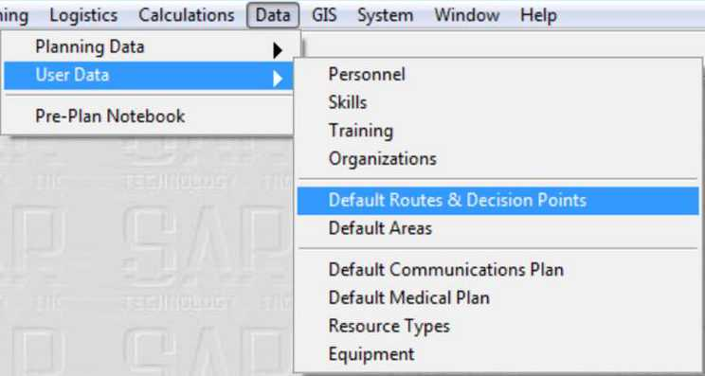
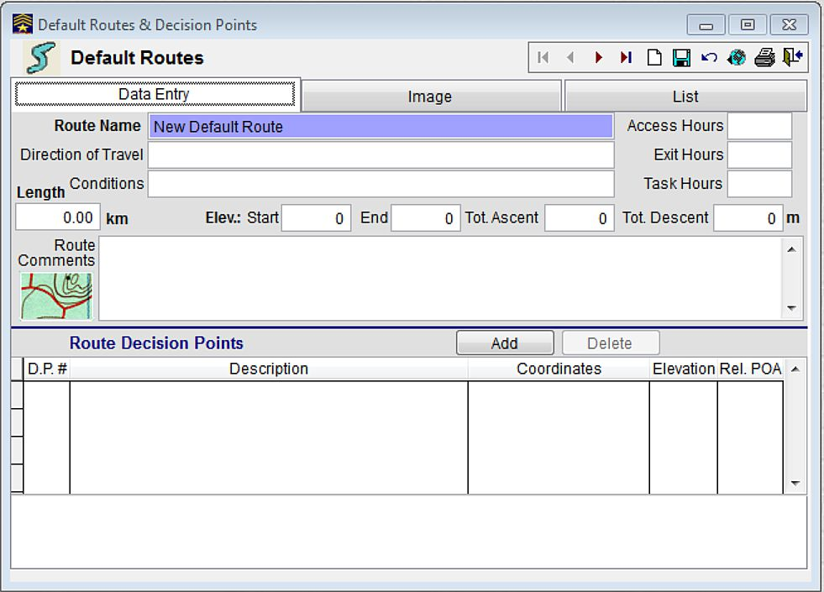
Default Routes & Decision Points
A permanent list of commonly-travelled routes and information on them.
Click Data, User Data then Default Routes and Decision Points to open the form.
Default Routes and Decision Points are automatically loaded into a new mission unless Minimal is chosen.

Slide 51
Default Routes & Decision Points
The Default Routes form permits details of commonly-travelled routes to be permanently saved in a Default Routes & Decision Points list
2. Click New then Data Entry.
3. Click Save when you have completed the form.

Slide 52
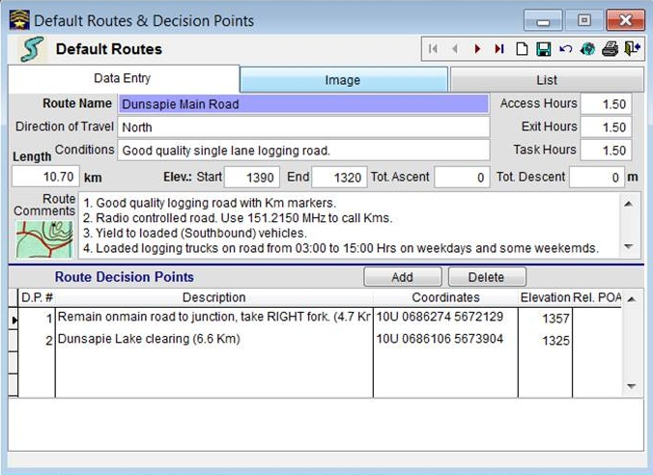
Default Routes & Decision Points – Data Entry - 2
Give the route a name, general direction of travel and conditions along the route.
Indicate the times to get to the route, search the route and to return to Base.
Insert the route length , elevations, and total ascent/descent
General comments on the route.
Indicate places where a person may inadvertently leave the route.

Slide 53
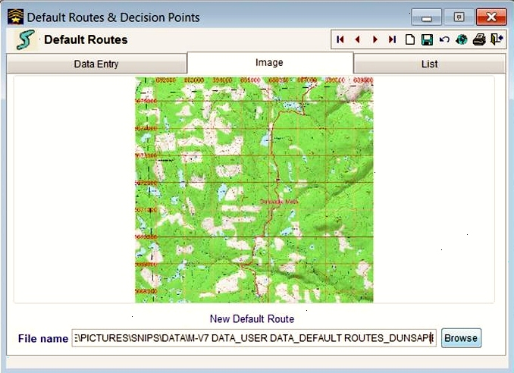
Default Routes & Decision Points - Image
An image of the Default Route can be stored with the Route Data.
1. Select Image then Browse
2. Browse to the desired Image File location then Double Click on it.

Slide 54
Snippets
Default Route data entry form

Slide 55
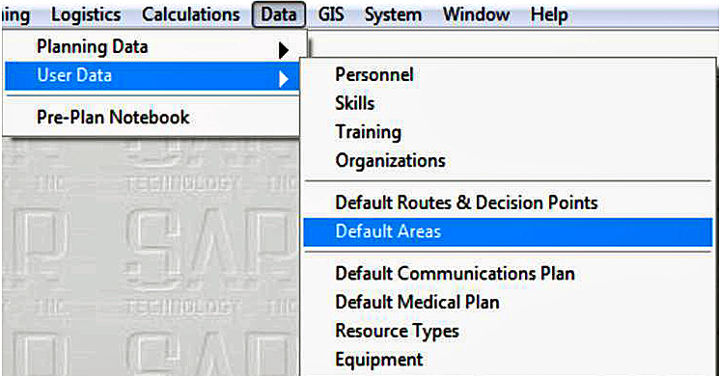
Default Areas - 1
The Default Areas form lists geographic areas to be permanently saved in the Default Areas table for use on future missions in the same areas.
1. Click Data, User Data then Default Areas to open the form.

Slide 56
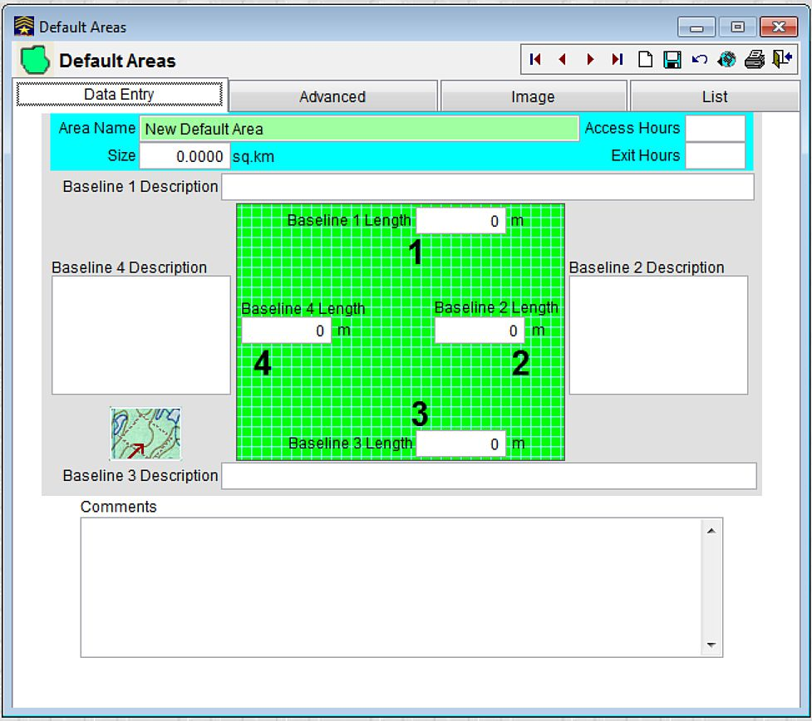
Default Areas – New Area
2. Click New then Data Entry.
3. Click Save when you have completed the form.

Slide 57
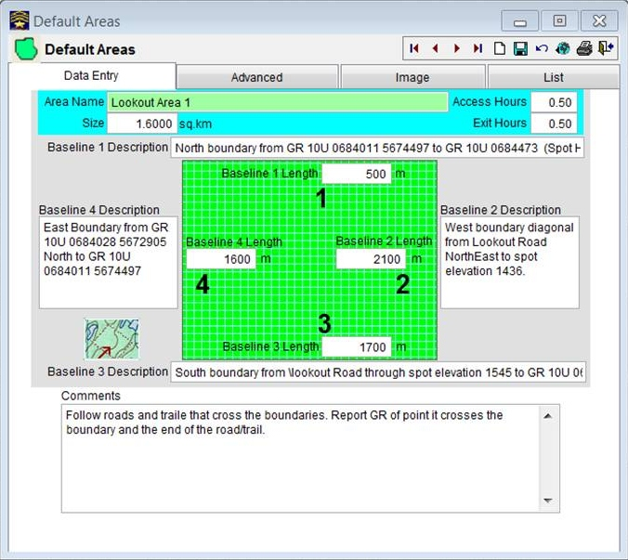
Default Areas – Data Entry - 1
Default Areas – Data Entry displays the geographic details of the area.
Enter the name of the area.
Enter the size of the area.
Enter a description and length of each Baseline.
Enter general comments about the area..
Enter the times to reach the area and return to the starting location.

Slide 58
Default Areas – Data Entry - 2
Use an area name that describes the area so that it is easy to find on the Default Areas list.
Enter the area size if available. This can be determined by using the Measure Area tool in the GIS module.
3. Baseline Length and Baseline Description of all four sides of an approximately rectangular search area should be recorded. They are necessary for Grid Search calculations.
4. It is a good idea to identify the geographic locations of the Baseline junctions.
5. Access and Exit Hours are calculated from the usual starting location such as the Command Post location.
6. Enter general details of the area in Comments.

Slide 59
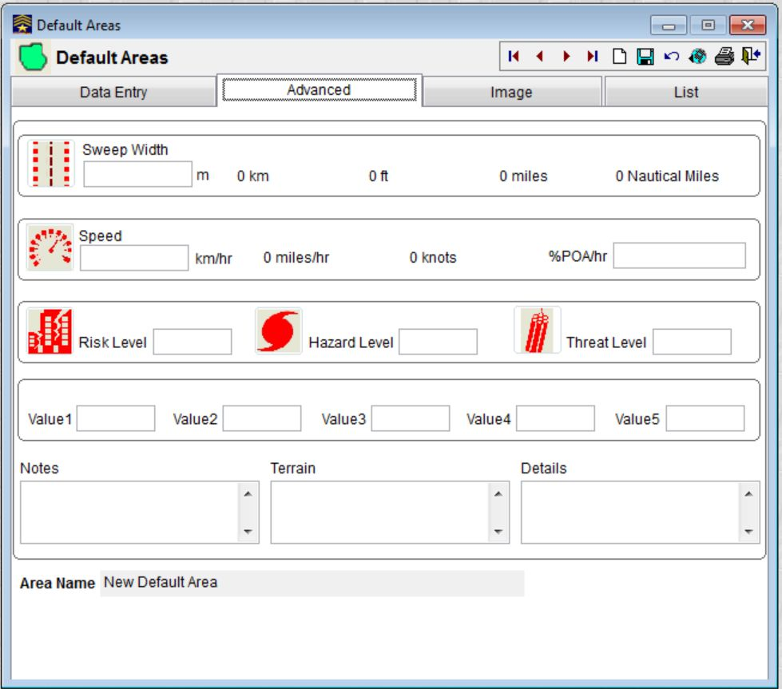
Default Areas – Advanced
The Advanced tab permits advanced information relating to the Default Area to be entered.
Sweep Width values entered here will be automatically used by the Coverage/POD Calculator.

Slide 60
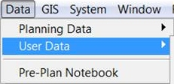
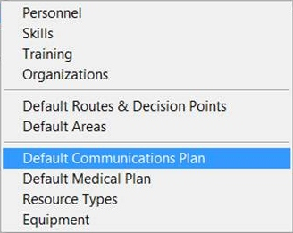
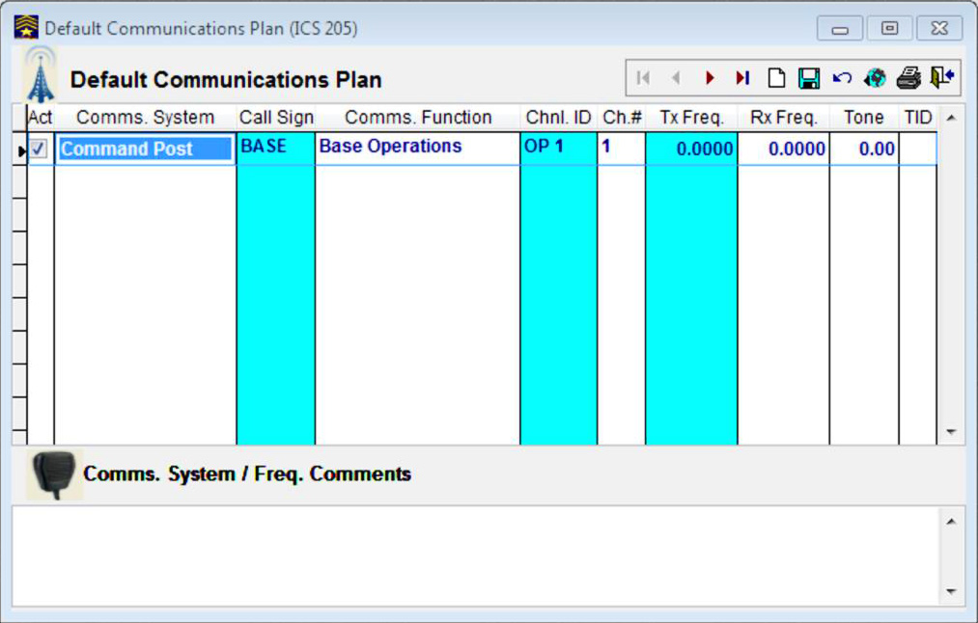
Default Communications Plan - 1
The Default Communications Plan lists and permanently stores communications data used for most missions.
Click Data, User Data then Default Communications Plan to open the form.

Slide 61
Default Communications Plan - 2
Enter information on communications systems, call signs and frequencies regularly used on a mission.
The first entry – Command Post – can not be deleted, but it can be renamed.
1. The Arrowhead indicates the item to be used or edited.
2. A Check mark indicates an active item to be shown on the Communications Log.
3. Enter a description.
4. Enter a Callsign.
5. Enter the purpose.

Slide 62
Default Communications Plan - 3
6. Enter the Channel Identification.
11. Enter the Channel Tone Number (if any).
7. Enter the radio Channel Number.
10. Enter the Channel Tone Frequency (if any).
8. Enter the Transmit Frequency.
9. Enter the Receive Frequency.
These columns may be left blank if you are unsure what to put in them.

Slide 63
Default Communications Plan - 4
11. Enter detailed comments on communications equipment and systems, operating schedules and procedures and other communications related items.

Slide 64
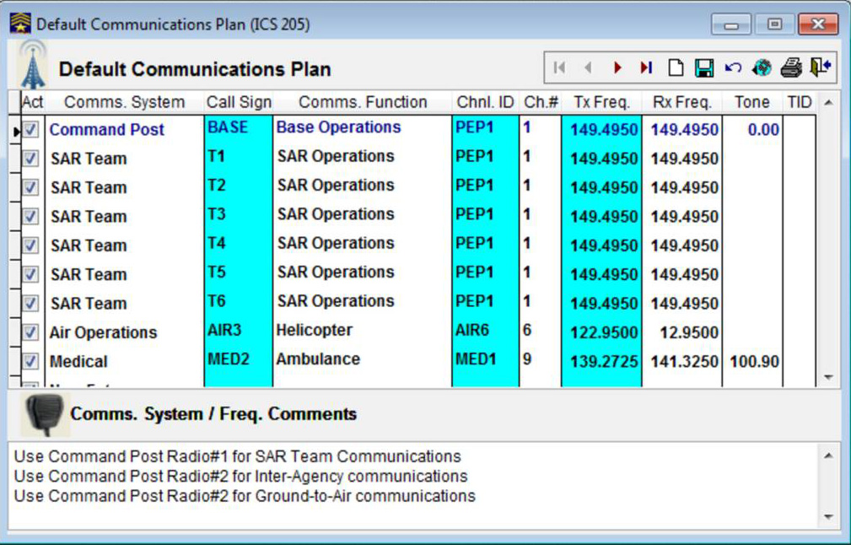
Default Communications Plan - 5
The completed Default Communications Plan.

Slide 65
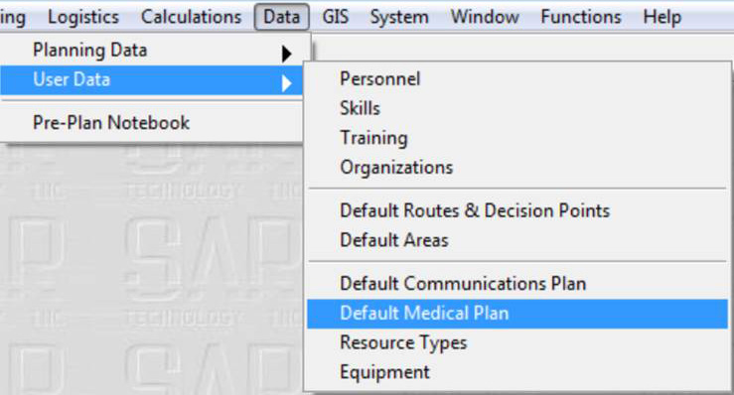
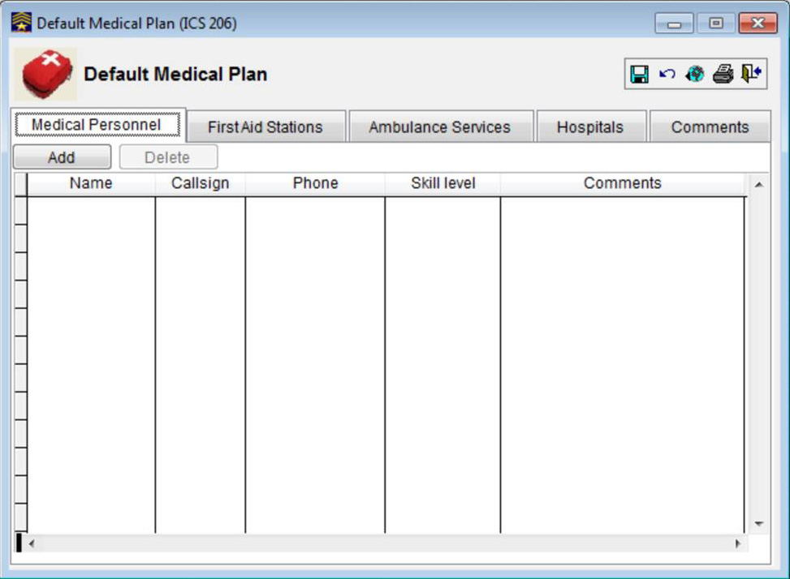
Default Medical Plan
The Default Medical Plan is designed to help prepare an orderly and effective response to any medical emergency that may occur during the mission.
Click Data, User Data then Default Medical Plan.

Slide 66
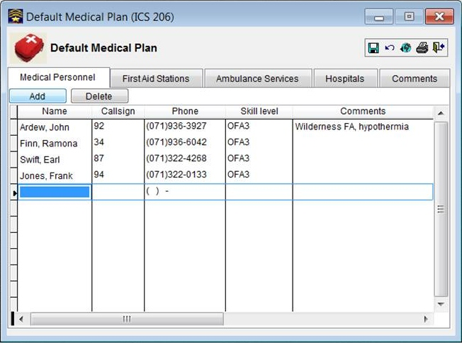
Default Medical Plan – Medical Personnel
The Medical Personnel table lists personnel who can be put on standby for a medical emergency.
1. Click Medical Personnel then Add.
2. Enter the Name and other information then click Save.
3. To delete an entry select the entry then click Delete.

Slide 67
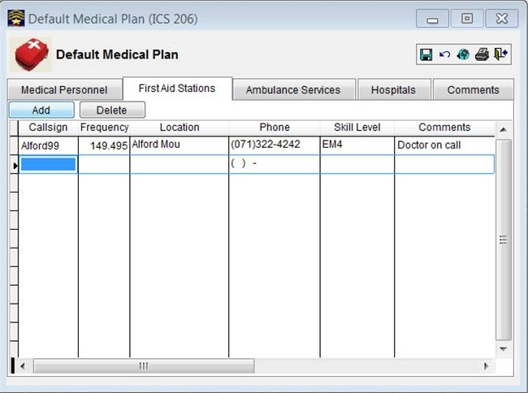
Default Medical Plan – First Aid Stations
The First Aid Stations table provides a list of First Aid stations available in the event of a a medical emergency.
Click First Aid Stations then Add.
Enter the Callsign and other information then click Save.
To delete an entry select the entry then click Delete.

Slide 68
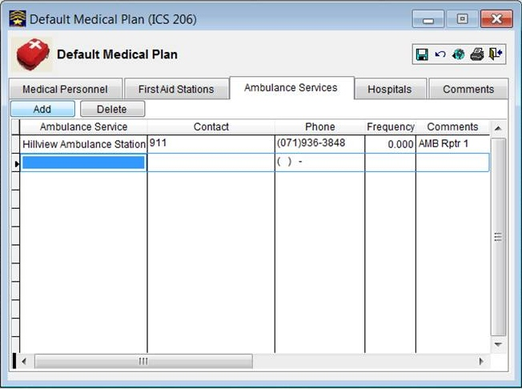
Default Medical Plan – Ambulance Services
A list of Ambulance Services, their Contact persons, Phone Number, Radio Frequency and general Comments relating to the Ambulance Service.
Click Ambulance Services then Add.
Enter the Name and other information then click Save.
To delete an entry select the entry then click Delete.

Slide 69
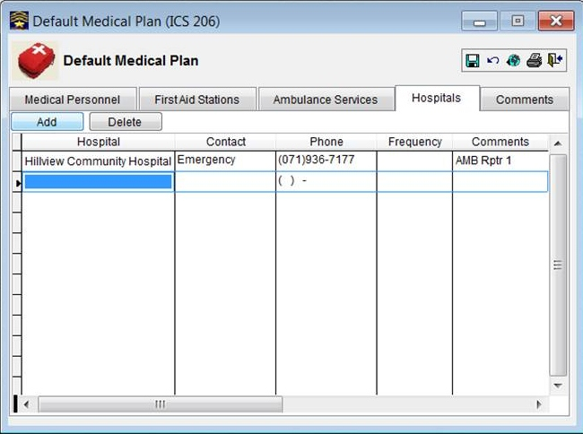
Default Medical Plan - Hospitals
A list of Hospitals, their Contact persons, their Phone Number, radio Frequency and general Comments relating to the Hospital.
Click Hospitals then Add.
Enter the Name and other information then click Save.
To delete an entry select the entry then click Delete.

Slide 70
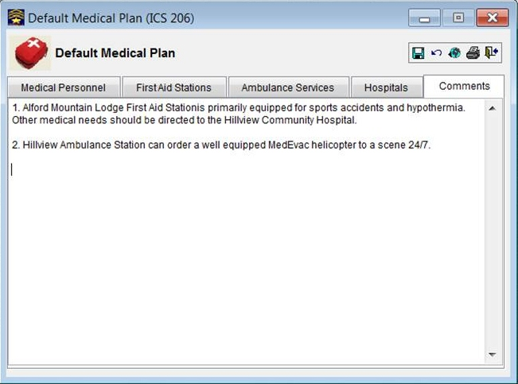
Default Medical Plan - Comments
The Comments field is used to store general comments relating to the Default Medical Plan.
1. Click Comments.
2. Type an entry into the data field then click Save.
3. To delete an entry highlight the entry then click Delete.

Slide 71
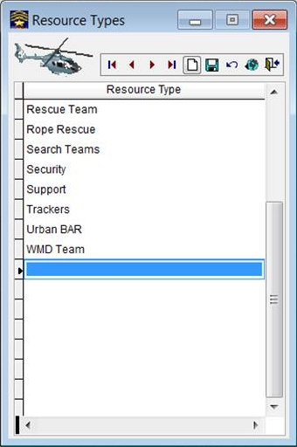
Resource Types
The Resource Types list contains a list of resources that are commonly used during missions.
To remove a resource, select it, click File then Delete.
Click New, enter the Resource Type then click Save.

Slide 72
Equipment
The Equipment form keeps track of the equipment inventory available to carry out a mission..
Method of sorting list
Equipment type and other information.
Displays a picture of the item.
List of all items recorded.

Slide 73
Equipment – Data Entry
Enter the information on an item of equipment.
1. Click Data Entry.
2. Click New.
3. Enter equipment information.

Slide 74
Equipment – Image
Locate and enter a picture of an item of equipment.
2. Click Browse then navigate to the image location.
1. Click Image.
3. Select the image, click OK, then Save.

Slide 75
‘Incident Commander Pro’ V7
Section 3
Creating a New Mission

Slide 76
Mission Narrative - 1
John Boyd and his son Bill enjoy the sport of geocaching. They wanted to establish their own geocache, and after looking at a map of the local area they decided to locate it near an abandoned forestry lookout tower in the general vicinity of Dunsapie Lake. Their plan was to drive to Dunsapie Lake in a pickup truck, towing a trailer loaded with two ATVs. They would use the ATVs to proceed from the lake to the lookout tower area. After finding a suitable location and setting up the geocache they would return to their pickup truck and drive home.
They left home at 09:10 and planned to return by 17:30 at the latest. When they did not return by 21:00 Bills wife Jean called 911 to report them missing. A policeman arrived at the Boyd residence at 21:30 to investigate. The following facts were noted in his report:
John and Bill are both in good health and were suitably dressed for their trip.
They were experienced ATV operators and had mostly travelled well defined ATV trails, usually in the company of other ATV enthusiasts.
They have been geocaching with others for the past year.
This was their first independent trip into an unknown area.
They carried food and water for two days and had cold weather coats, a tent and camping equipment in case they had to remain out overnight.
They have a GPS receiver, two FRS radios and a CB radio, which was installed in their vehicle.
They both have a cellular telephone but the area they are in does not have cellular coverage.

Slide 77
About the Mission Quick Start Wizard
The Mission Quick Start Wizard provides a fast way of initiating a new mission, entering only the minimum amount of essential information.
The Quick Start Wizard steps the user through the forms which have to be completed to initiate a new mission and then opens the Communications Log.
In order of entry these initiation steps are:
Step 1. Open a Mission
Step 2. Organize a Response
Step 3. Create an Operations Plan
Step 4. Log Mission Activities
These steps must be completed in sequence.

Slide 78
Open Mission Quick Start Wizard
Click File then Mission Quick Start Wizard…

Slide 79
Mission Quick Start Wizard
Click Normal if you want to use Mission Routes or Mission Areas as part of your Operations Plan. Click Minimal if you do not want to use them.
If Normal is selected, Default Missions Routes and Areas will be automatically be added to the mission.

Slide 80
Open a Mission
Click Mission to open a new mission or to open an existing mission.
If Normal is selected, Mission routes and Areas can be created for the mission or the Default Missions Routes and Areas will be automatically added to the mission.

Slide 81
Open the Mission
1. Enter the Mission Name
2. Enter the Mission Number
3. Enter the Ref. File# and Cross Reference number, if any.
4. Enter the Op. Pd. Start date/time
5. Click Open Mission

Slide 82
Open the Mission - 2
Confirmation that the mission has been opened momentarily flashes on the screen.

Slide 83
Check-In Personnel
Click Check-In Personnel to open a new mission or to open an existing mission.

Slide 84
Check- In Personnel - 2
Everybody involved in the mission must register when they arrive on-site using the Check-In Personnel form.
If personnel are not checked-in they will not be listed by the software and cannot be allocated to any assignments.
The check-in list also generates lists of people on-site who can be allocated to assignments.
the Check-In form also records the distance travelled to the on-site location and the elapsed hours the individuals remain on-site before checking out.

Slide 85
Check- In Personnel – Select From List
1. Click Check-In.
2. Click a name from the list to highlight it.
3. Click OK to check the person in.
4. The checked-in person’s name appears on the list.

Slide 86
Check- In Personnel – New
1. Click Check-In.
2. Click New.
3. Enter Data
5. Click OK.
4. Select Organization.
6. The checked-in person’s name appears on the list.

Slide 87
Mission Routes
Default Routes can be used for the mission or you can create Mission Routes as you need them.
2. Click Use Default Routes if you are going to use them.
1. Click Routes.
To create a Mission Route refer to Preparing For Use - Default Routes and Decision Areas section.

Slide 88
Mission Routes – Add a Default Route
Selecting a Default Route for use with the Mission.
To select a Default Route click New, Select, then choose a route from the drop-down list.

Slide 89
Mission Routes – Create a New Route
Creating a New Route for the Mission.
To create a Mission Route click New, then New Route.

Slide 90
Mission Routes – Create a New Route – Data Entry
Enter information on the route and it’s condition.
1. Click Data Entry.
2. Enter a Name for the route.
3. Click Route and insert as much information as you can.
4. Click Save to Default if you want this to become a Default Route.
The Conditions field should show the route conditions at the time it is travelled.

Slide 91
Mission Routes – Create a New Route – Decision Points
Describe locations along the route where a person may inadvertently leave the route.
1. Click Decision Points.
2. Describe Decision points along the route.
3. Use Add and Delete to add or delete Decision Points.

Slide 92
Mission Routes – Create a New Route – Image
1. Click Image.
2. Click Browse.
1. Click Data Entry.
1. Click Data Entry.

Slide 93
Mission Routes – Create a New Route – Browse - 1
If the Mission Route is created using the GIS module…
1. Create the Route on the Mission Map, then save the map.
2. Navigate to the ICv7 folder, then click My_Maps.
3. Double Click MyBackups.
1. Click Image.

Slide 94
Mission Routes – Create a New Route – Browse - 2
4. Double Click Mission.
5. Double click the last saved map for the Mission.
If the image is located in another folder, navigate to that location.

Slide 95
Mission Areas
Default Areas can be used for the mission or you can create Mission Areas as you need them.
2. Click Use Default Areas if you are going to use them.
1. Click Areas.
Default Areas may be quickly allocated to the Mission, or new areas created as needed.

Slide 96
Create Mission Area
The List of Mission Areas

Slide 97
Create Mission Area
Enter information into the Mission Areas data entry form

Slide 98
Mission Areas - Advanced

Slide 99
Mission Areas - Image
An image, such as a map, can be added to the Mission Areas form

Slide 100
Assignment Form/ICS 215 Operations Plan
The Assignment Form and Operations Plan lists the tasks to be performed and describes them in detail.
Click ICS 204.
The Assignment Forms describe the tasks to be carried out for completion of the mission, and assign personnel and equipment to each task.

Slide 101
Operations Plan and Assignments
Lists all and task assignments
ICS 215 Operations Plan lists all Operations assignments.
ICS204, 204a Assignment Form and Debrief describes the assignment and debriefing notes once the assignment is completed.

Slide 102
ICS 215 Operations Plan
The Operations Plan is a list of all the Assignments that have been created

Slide 103
ICS 204 Assignment Form - Header
1. Enter the Assignment Name
2.Select the task Status from the pull-down menu.
3. Click Prepared by…
4. Click the Name, then OK.
The remaining fields in this area are completed by the computer.

Slide 104
ICS 204 – Assignment Form – Call Signs
Select a Call Sign, Tx and RX channel IDs to be used on the task. Call Signs can also be added or deleted as required.
1. Create a Call Sign for the task.
2. Select a TX and Rx Ch ID from the drop-down list.
3. Click Add if a second Call Sign is needed.
4. Select a Call Sign to be deleted from the task then click Delete. .
Task Call Signs are automatically added to the Mission Communications Plan and Communications Log.

Slide 105
ICS 204 Assignment Form – Assignment Type
Select Assignment and Resource types, and the time the assignment is to start.
1. Select Assignment Type from drop-down list.
2. Select Resource Type from drop-down list.
3. Insert the Start Time for the assignment.
4. Insert the Status Changed time, if any.
The current Assignment Status is also displayed in the ICS 309 Communications Log and in the Mission Status Display.

Slide 106
ICS 204 Assignment Form – Assignment Times
Enter task timings, POA, POD and the number of people required for the task.
1. Enter Access hrs. - the time required to reach the task location.
2. Enter Task hrs. - the time required to complete the assigned task .
3. Enter Exit hrs. - the time required to return to base.
4. Enter the Probability of Area (POA).
5. Enter the Probability of Detection (POD).
6. Enter the # of People Required to complete the task.
Most of this information is automatically taken from the Mission Routes and Areas files, or can be inserted manually.

Slide 107
ICS 204 Personnel and Comments
Adding personnel to the task
1. Click Add to open the Assignment Personnel Selector.
2. Click the Sel check boxes of the personnel to be added.
3. Click Allocate to Assignment .

Slide 108
ICS 204 Personnel and Comments - 2
What are all the boxes for?
The Pointer indicates the Active Row.
Add – Add a name(s) to the task.
Delete – Delete the selected Name from the task.
Clear Call Sign clears the task call sign.
Name, Pers. CallSign and Cell Phone come from the Personnel Table.
Assignment Role – Manually entered when the person is assigned to the task .
Call Sign – Select from the drop-down list
Number of persons required for, and allocated to the task

Slide 109
ICS 204 Personnel and Comments – Assignment Comments
The Assignment Comments field is used to record general comments relating to the assignment.
Comments could include required equipment, safety warnings, escape routes, weather forecasts etc.
These Comments will also be displayed in the ICS 209 Mission Status Summary.

Slide 110
ICS 204 Assignment Form – Assignment Details
Records the specific details of the assignment. It can include travel directions, field instructions, suggested tactics, recommended equipment, etc.
The Assignment Details form is the basis for the Team Briefing prior to their departure. Sufficient information should be included for the briefer to produce a full SMEAC briefing.
The task is now ready to be handed over to Operations for who will brief the team and send it on it’s way.

Slide 111
ICS 204 Assignment Form – Assignment Debrief - 1
The Assignment Debrief form is used to document information obtained by a team during the course of their assignment.
The Assignment Debrief form is prepared after the assignment is completed.
1. Select Team Leader’s name.
4. Enter name.
2. Enter date/time task completed.
3. Enter a Probability of Detection (POD).
5. Enter date/time of debrief.

Slide 112
ICS 204 Assignment Form – Assignment Debrief - 2
Record the information obtained by the team while they were completing their assignment.
Record comments or suggestions that the team believe would be helpful with the ongoing execution and investigation of the incident

Slide 113
ICS 204 Assignment Form – Assignment Debrief - 4
Record all potential clues or items found during the assignment.
Record any difficulties or hazards noted by the team during the assignment.

Slide 114
ICS309 – Communications Log
The Communications Log is the central location in the program for documenting all types of information communicated during the course of the incident.

Slide 115
Communications Log - Call Sign List
The Communications Log displays a list Call Signs assigned to the task from the Mission Communications Plan and the Mission Task Assignments.
Permanent Call Sign entries.
Call Signs automatically entered from the Mission Communications Plan.
Call Signs automatically entered from the Task Assignment forms.

Slide 116
Communications Log – Duplicate Call Signs
1. If a Call Sign is checked on the Mission Communications Plan, it appears on the Communications Log.
2. This Call Sign came from a Task Assignment form.
Ensure all Task communications are entered against the Task Call Sign.

Slide 117
Communications Log – About Call Signs
Call Signs in the “Green Zone” are from the Mission Communications Plan.
Call Signs in the “White Zone” are inserted using the “Add CallSign” button or,
- from a Task Assignment form.
Task CallSigns appear on the Communications Log when the task is made active and disappear when the task is closed.
Task Communications log information also appears on the Mission Status Display.

Slide 118
Communications Log -Call Sign Selection
From and To Call Signs can be quickly selected from the Call Sign list.
Pointer indicates the selected Call Sign.
1. Click the button that the call is From.
2. Click the button that the call is To.
Base is automatically copied to the To column when another call sign is selected in the From column.

Slide 119
Communications Log – Add new Call Sign
1. Click New Call Sign to open the Mission Communications Plan.
2. Enter the new Call Sign.
The new Call Sign appears on the Communications Log.
Multiple all Signs can be entered at the same time.

Slide 120
Communications Log – Log Entries - 1
From and To – Selected from the Call Sign list.
Date and Time – entered by the program.
Status - entered from the Task Assignment form.
Note: The time may be changed if necessary.

Slide 121
Communications Log – Log Entries - 2
Location – enter location data in UTM format.
Elev. Enter elevation data (if needed).
Clue# - Enter Clue number (if needed.)
Dialogue – Enter the gist of the transmission.
Note: Location is a place to store location data for use elsewhere. It must be in UTM format (see next slide).

Slide 122
Communications Log – Entering the UTM Location
When entering the UTM grid reference, type it in as a continuous sequence with no spaces. Do not enter locations in Latitude/Longitude.
1.Locate the UTM Location on the GPS display.
Ignore the letter following the UTM Zone number
2. Enter the UTM Zone number.
3. Enter the Easting, (top row) then the Northing.
The Easting and Northing each require 7 digits. If there are only six digits, add a leading zero.

Slide 123
Communications Log – Assignment Information
Calling station Call Sign and channel data.
Assignment personnel drop-down list
Active log entry.
Assignment information.

Slide 124
Communications Log – Sort Entries

Slide 125
Communications Log – Using the Timer - 1
1. Set time in minutes and tenths of a minute.
2. Click the stopwatch to start the timer.
3. (Optional) Click the bell to enter a reminder.

Slide 126
Communications Log – Using the Timer - 2
4. At 10 seconds the time digits turn yellow .
5. At 5 seconds the time digits turn red and a series of beeps are heard.
6. At 0 seconds a long beep sounds and the timer resets.

Slide 127
Communications Log – Using the Timer - 3
7. The timer starts to count down again!
8. Click the button to silence the timer and return to the clock.
When cancelled, the timer will continue to run in the background but there will be no beeps!
To cancel the timer, click on the Cancel button.
Cancelling the timer resets it to the indicated time interval.

Slide 128
Communications Log – Resizing - 1
The Communications Log is resized the same as other windows, but…
At normal size there is a space here…
When resized the Dialogue column expands to the border.

Slide 129
Communications Log – Resizing - 2
1. If the From and To columns disappear…
2. Pull the right hand Dialogue border slightly to the left.
3. The From and To columns should now remain visible.
4. If they don’t, pull it over a little more.

Slide 130
Moving Right Along...
At this point we have:
Opened a new mission.
Checked in personnel.
Created mission routes and areas.
Created team assignments, and
Opened the Communications Log.
What’s next?
If the search is small, just keep on going.
If time is available. Add management information.
Create an incident map using the GIS module.
Set up team tracking on the incident map.
For more complex searches create search areas and POAs, use POD tables and subject behavior profiles to assign priorities and narrow down the search areas.

Slide 131
Snippets
Everybody involved in the mission must register when they arrive on-site using the Check-In Personnel form.
The Resource Types list contains a list of resources that are commonly used during missions.

